Slide 1
ENTERPRISE WEB-BASED GIS FOR THE LOUISVILLE WATER COMPANY
Christina Gnadinger
GIS Applications Developer
Louisville Water Company

Slide 2
Agenda
LWC Overview
Current GIS Resources & Strategies
From Old to New
What’s Next?
Wrap Up

Slide 3
Louisville Water Company

Slide 4
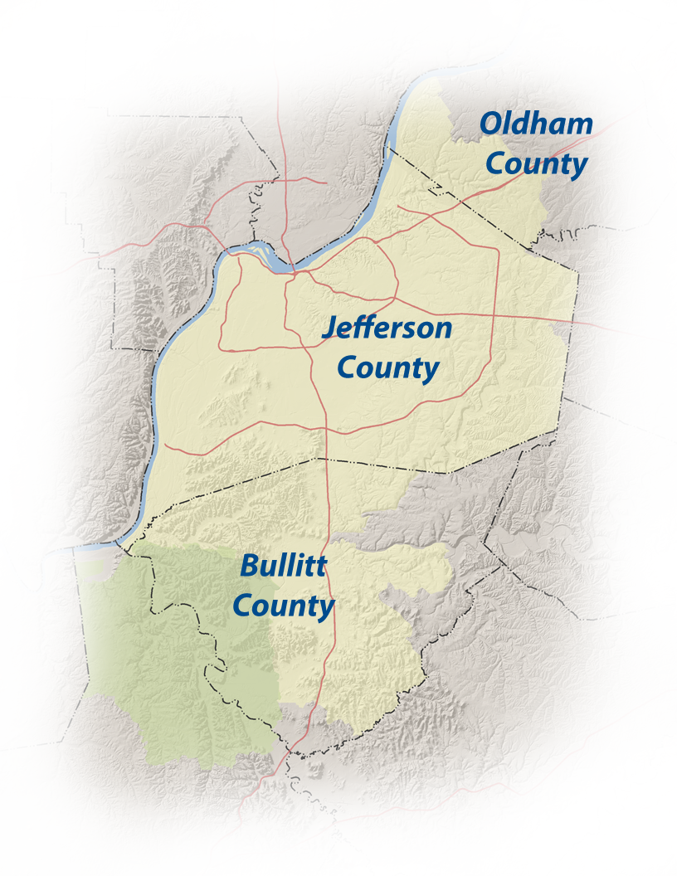
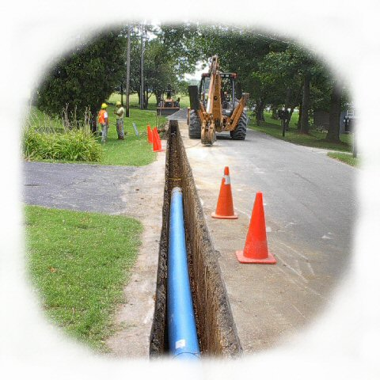
Louisville Water Company
> 302,000 SERVICE
CONNECTIONS
620 SQUARE MILE
SERVICE AREA
> 4,100 MILES
OF PIPE
> 51,000
VALVES
> 23,500
FIRE HYDRANTS

Slide 5
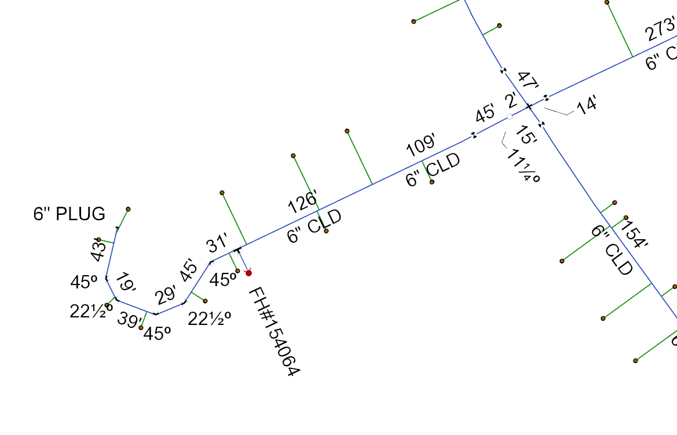
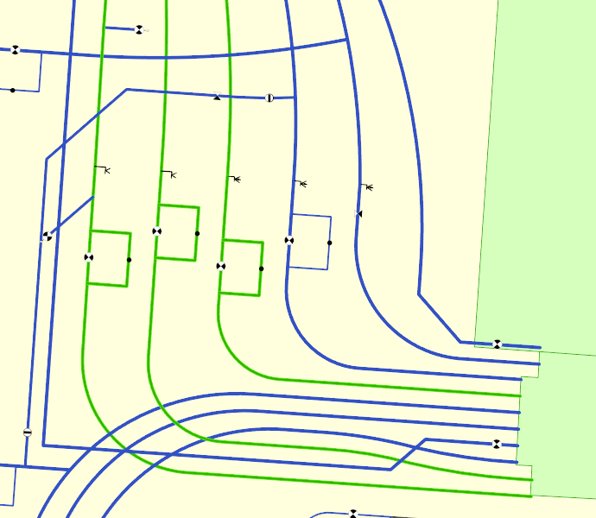
GIS Resources
LWC GIS infrastructure

Slide 6
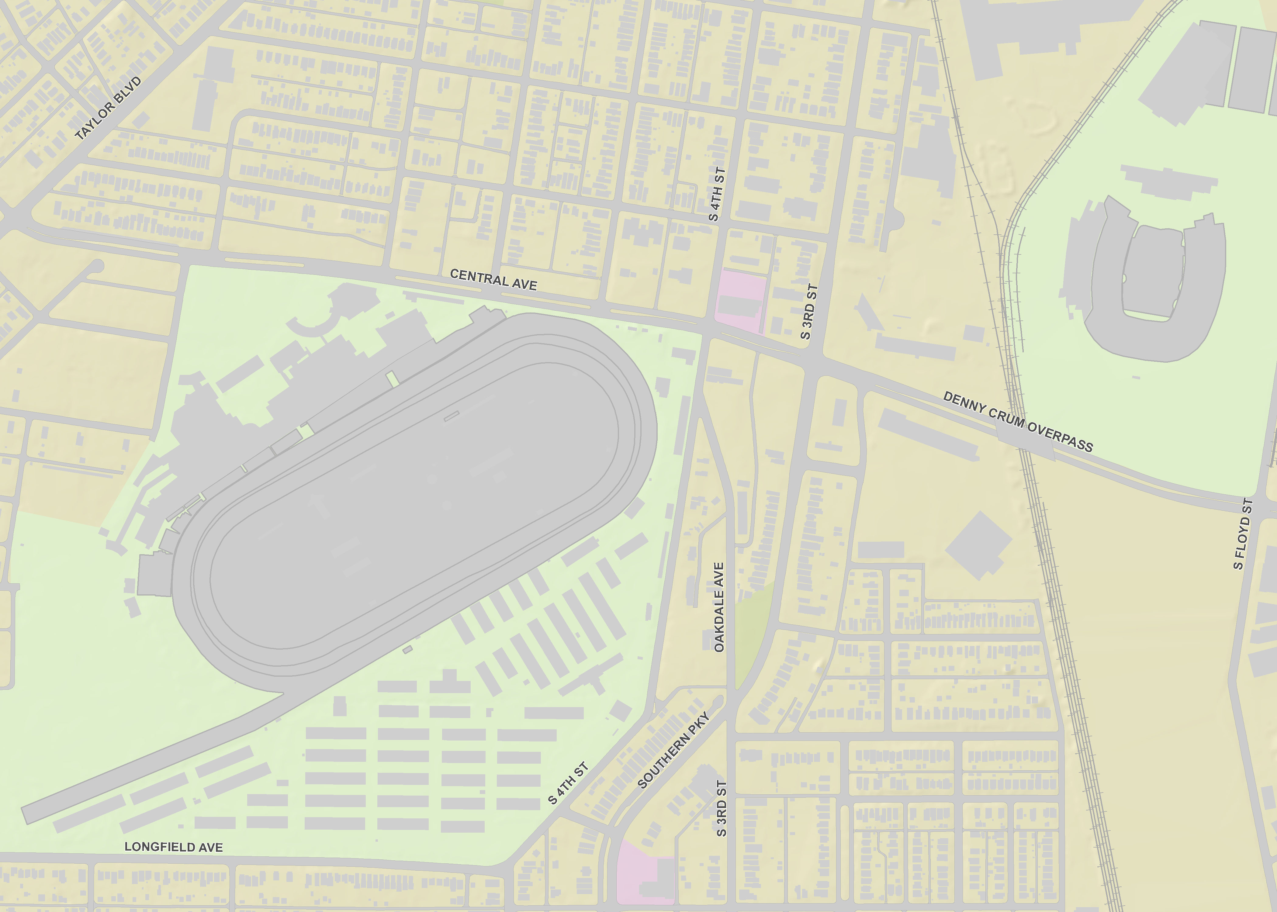
GIS Resources
Base Map Information

Slide 7
Current GIS Strategy
Varying levels of internal GIS users
Power Users / Editors
General Users
Mobile GIS Users
General Users

Slide 8
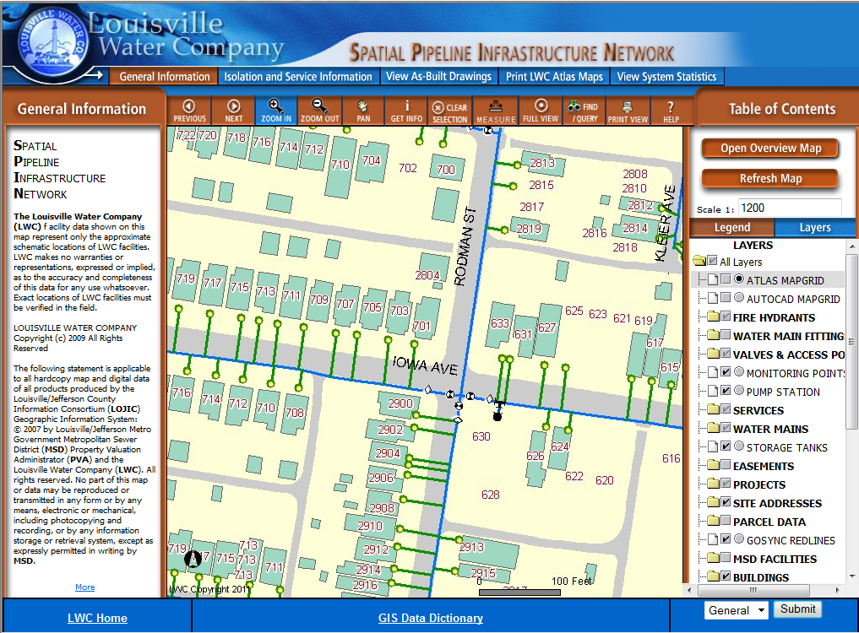
Existing Web Application

Slide 9
Existing Web Application
Launched in 2004
ArcIMS 9.3.1
Complex Dynamic Services

Slide 10
How do we improve the new application?
Design
Performance
Functionality

Slide 11
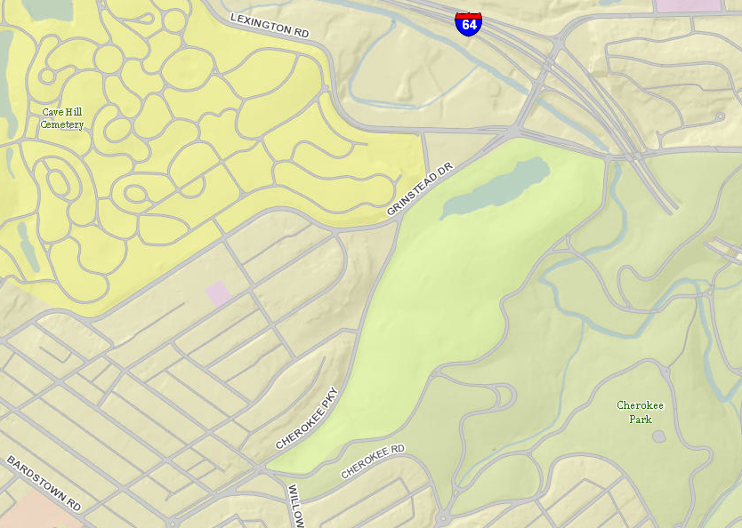
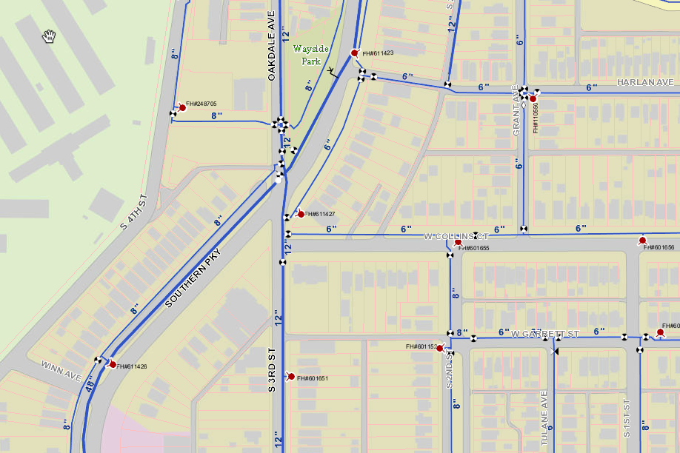
Design Challenges
Aesthetics
Efficiency
Realistic Expectations

Slide 12
PERFORMANCE Challenges
Virtual Server Configuration
How many servers?
# of Cores per SOC / SOM | # of SOCs | Number of Instances | Time to Complete
4 | 2 | 8 | 01:38:30
4 | 2 | 8 | 01:40:05
2 | 2 | 4 | 04:04:08
2 | 4 | 8 | 02:07:28
2 | 4 | 10 | 01:56:43
2 | 4 | 12 | 01:41:26
2 | 4 | 14 | 01:29:43
2 | 4 | 16 | 01:25:54
2 | 4 | 17 | 01:27:21
2 | 4 | 18 | 01:30:18
How powerful should they be?

Slide 13
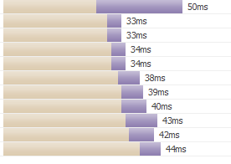
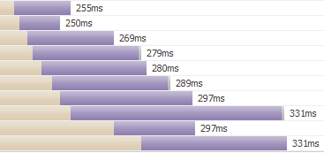
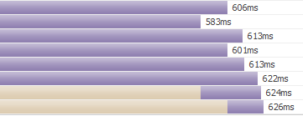
PERFORMANCE Challenges
System
Cache
Strategies
256 vs. 512 pixel tiles?
Compact vs. Exploded?
PNG8, 24 or 32?
Local Server Storage vs. Network?
Which is faster?

Slide 14
FUNCTIONALITY
Wouldn’t it be nice to give your General Users functional GIS abilities within the web application?
Research
Reporting
Map Making
Digital Drawings
System Linkages
Valve Tracing

Slide 15
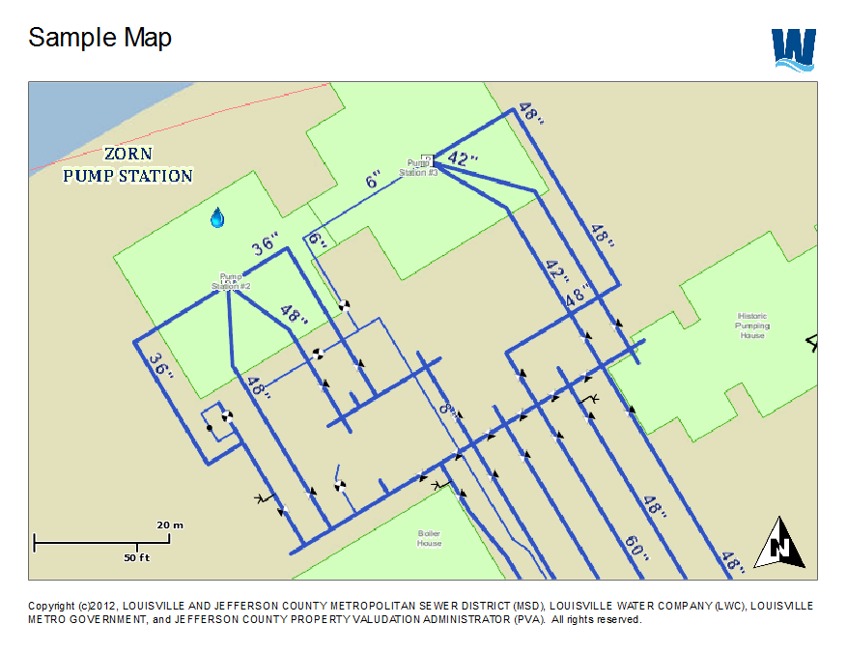
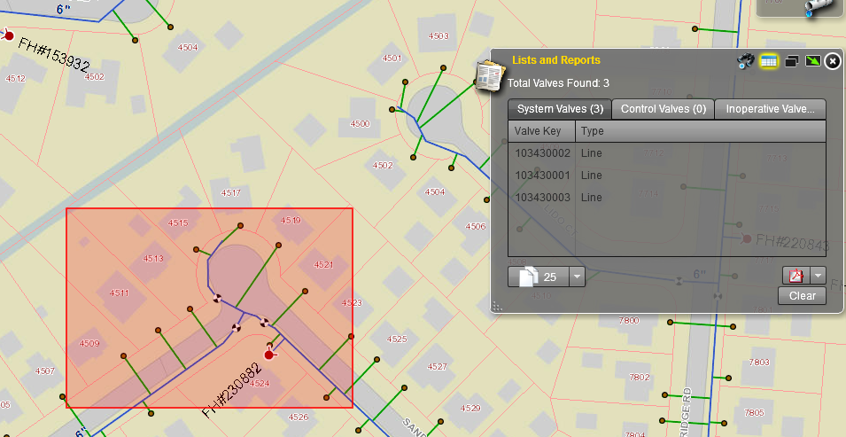
FUNCTIONALITY
GIS Research Tools, Basic Reporting, & Map Making

Slide 16
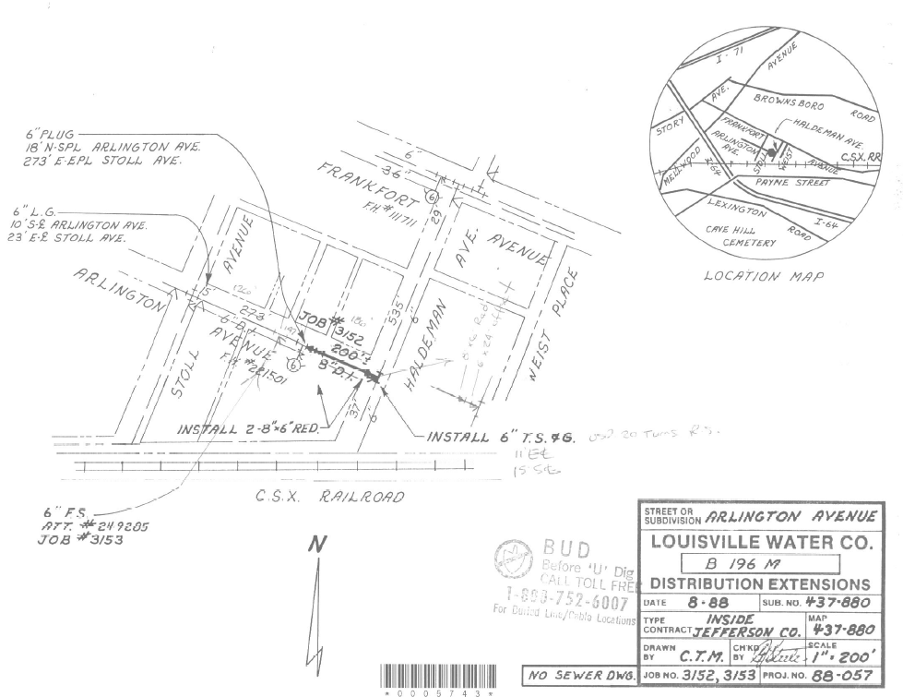
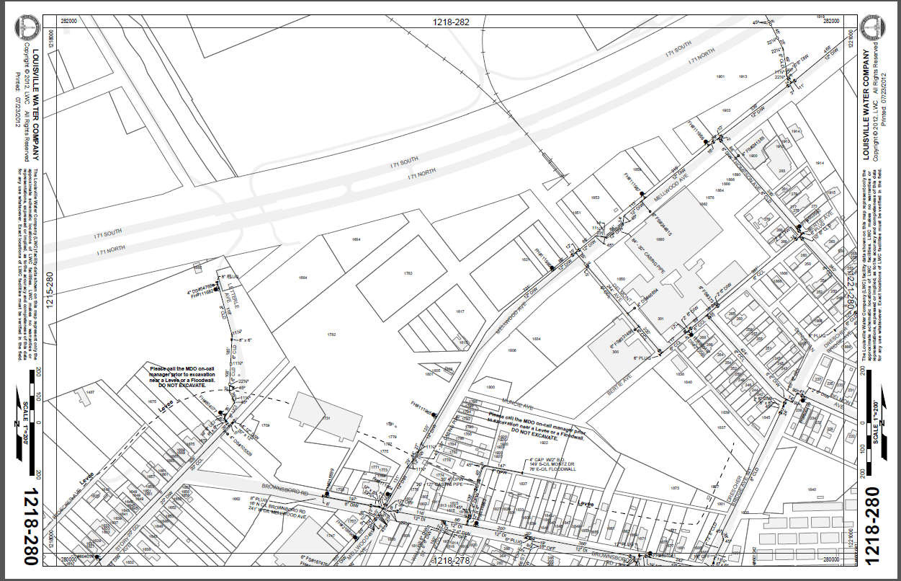
FUNCTIONALITY
Digital Drawing Access
AsBuilts
Construction Drawings
System Infrastructure Maps

Slide 17
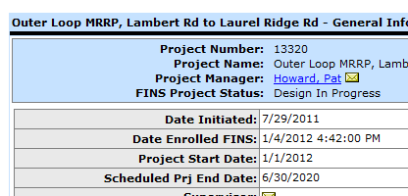
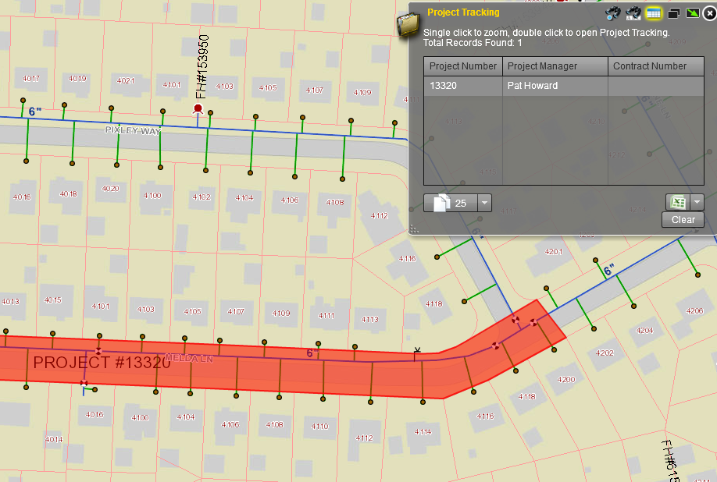
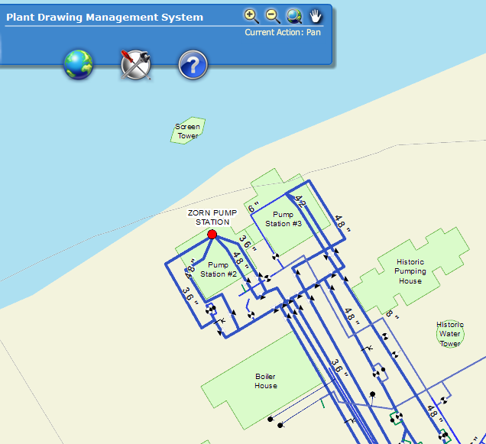
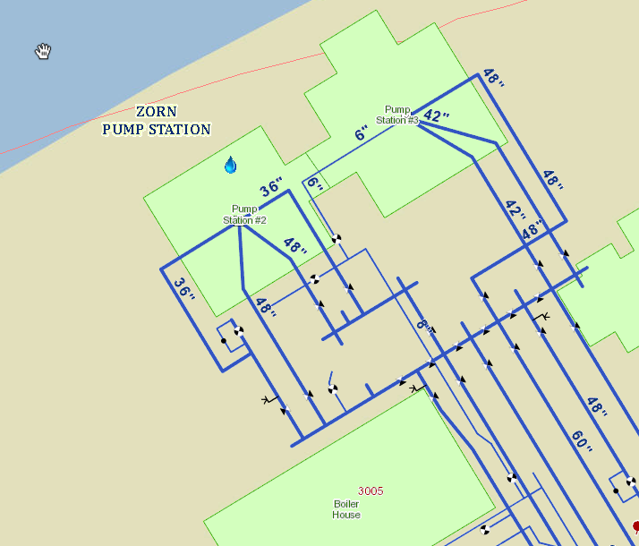
FUNCTIONALITY
Links Between Systems
Project Tracking
Plant Drawing Management System

Slide 18
FUNCTIONALITY
Valve Tracing

Slide 19
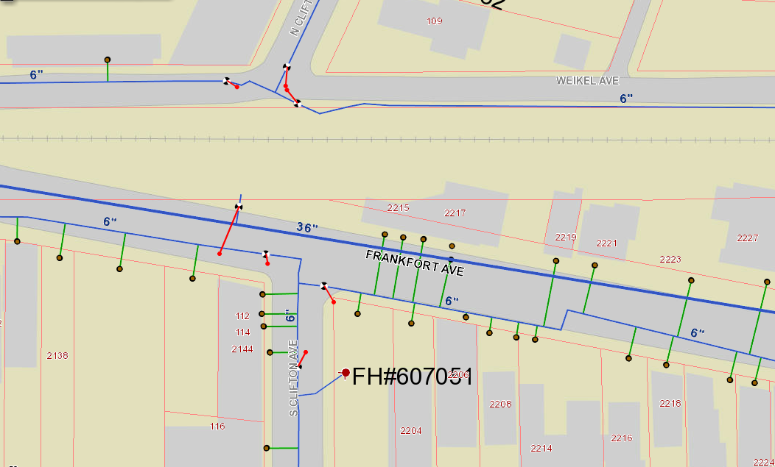
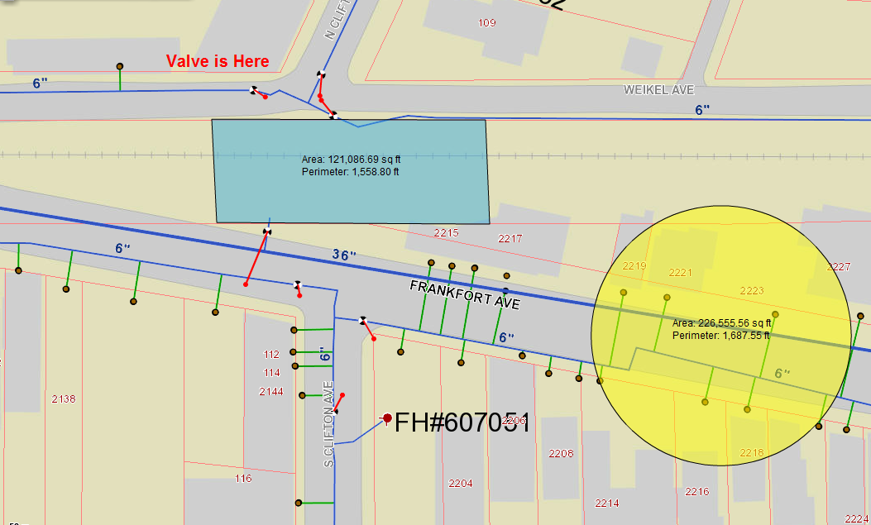
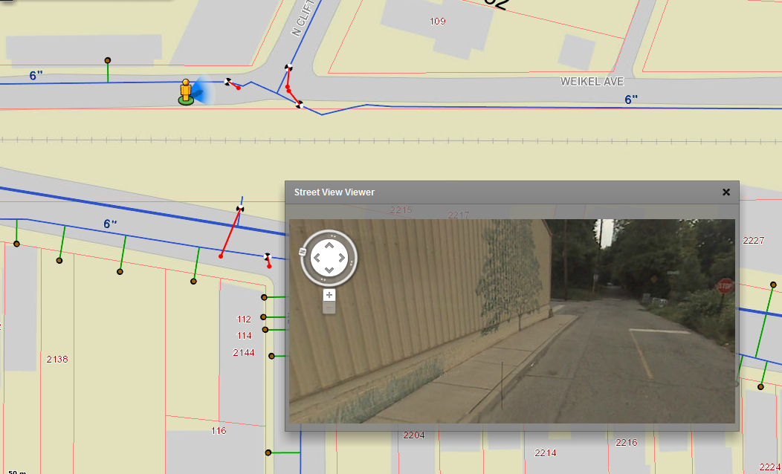
FUNCTIONALITY
Other Tools
Display GPS Locations
Draw and Sketch Tools
Google Street View

Slide 20
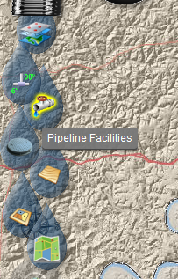
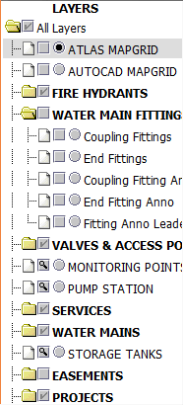
FUNCTIONALITY
Modernized Interface

Slide 21
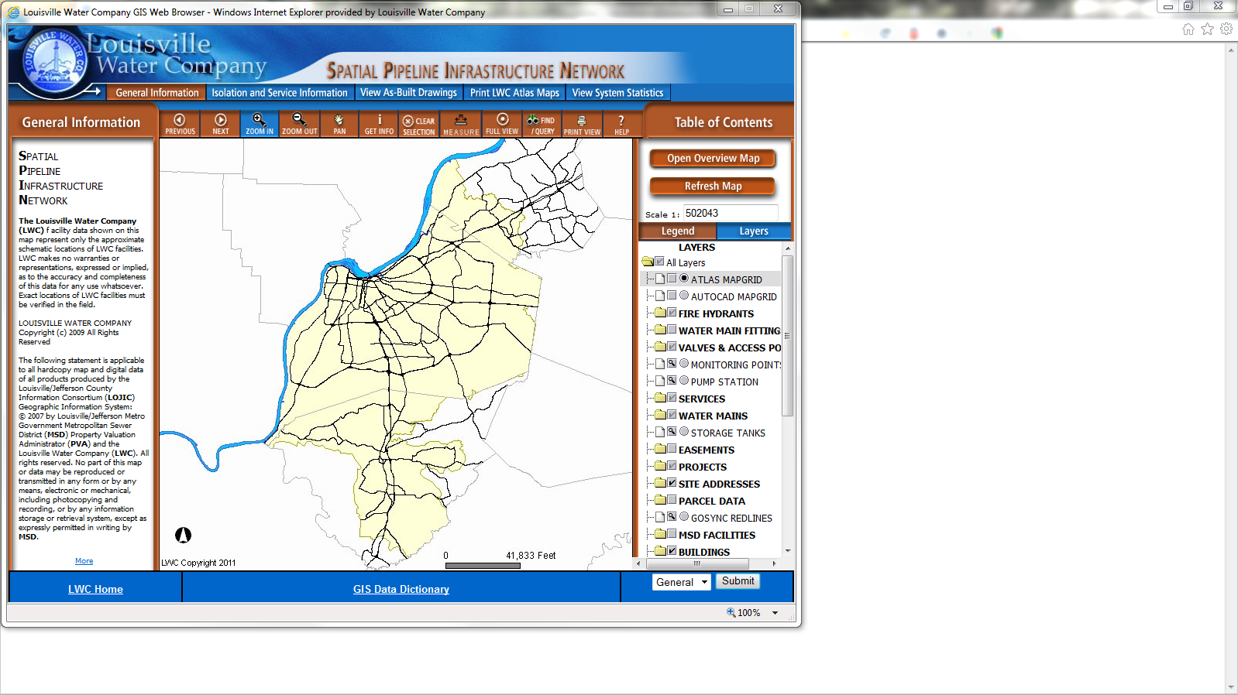
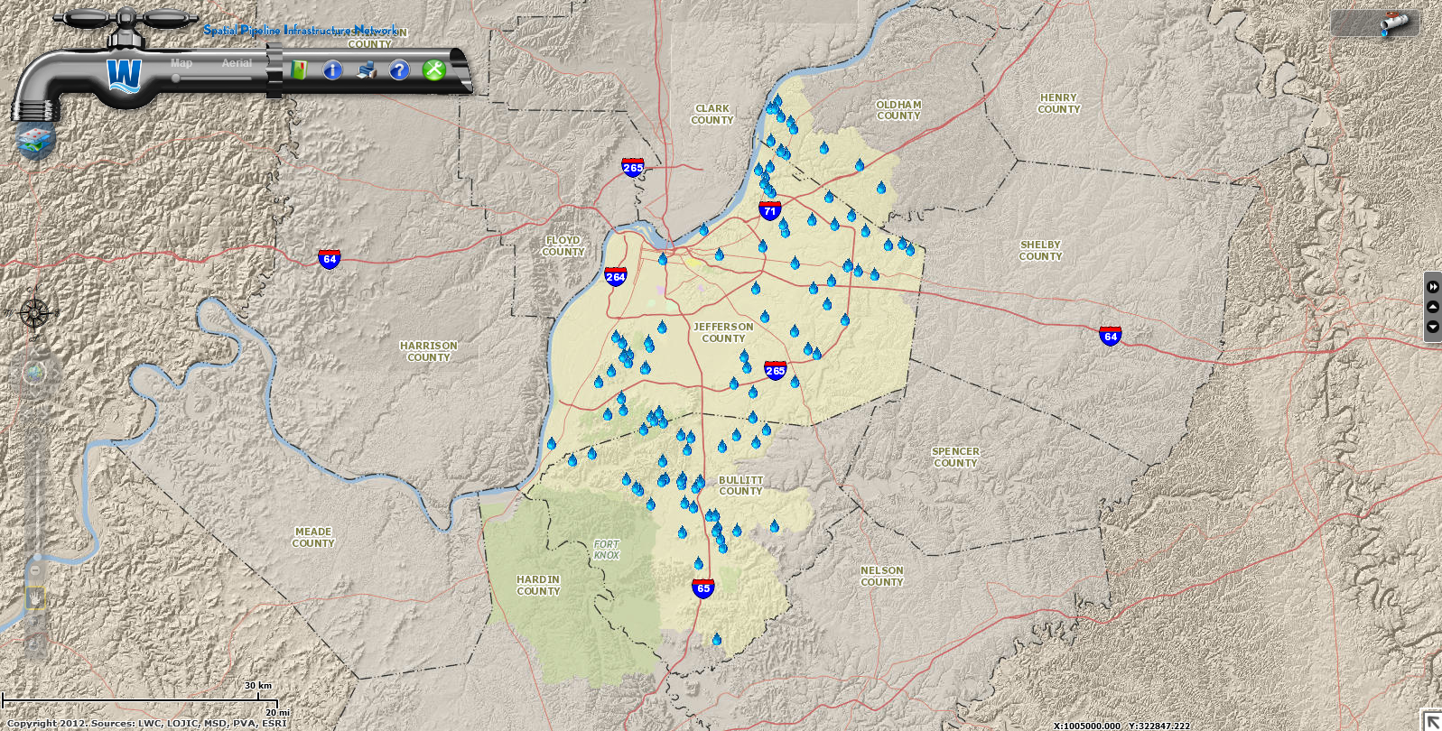
FUNCTIONALITY

Slide 23
What’s next?
Web Application
Upgrade to ArcGIS for Server 10.1 / Flex Version 3.0 +
'SPIN' off web applications

Slide 24
What’s next?
Other GIS Development
Strategies driven by work process needs
Mobile Development

Slide 25
WRAP UP
LWC Overview
Current GIS Resources & Strategies
From Old to New
What’s Next?
Wrap Up

Slide 26
Questions?
Christina Gnadinger
CGnadinger@lwcky.com

