Slide 1
A Public Sector Career Working In GIS
Ken Bailey, GISP
LOJIC Customer Support Specialist

Slide 2
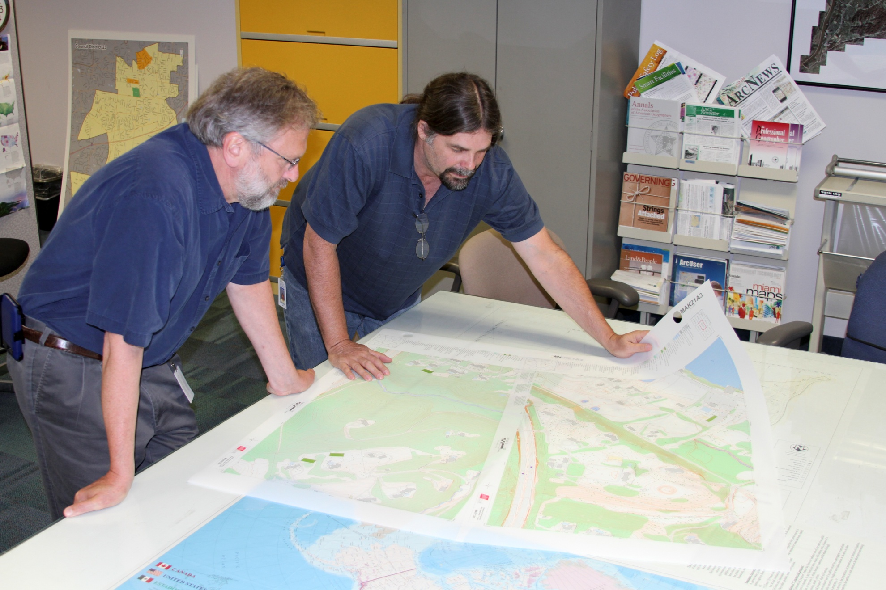
I work with collogues and Mylars

Slide 3
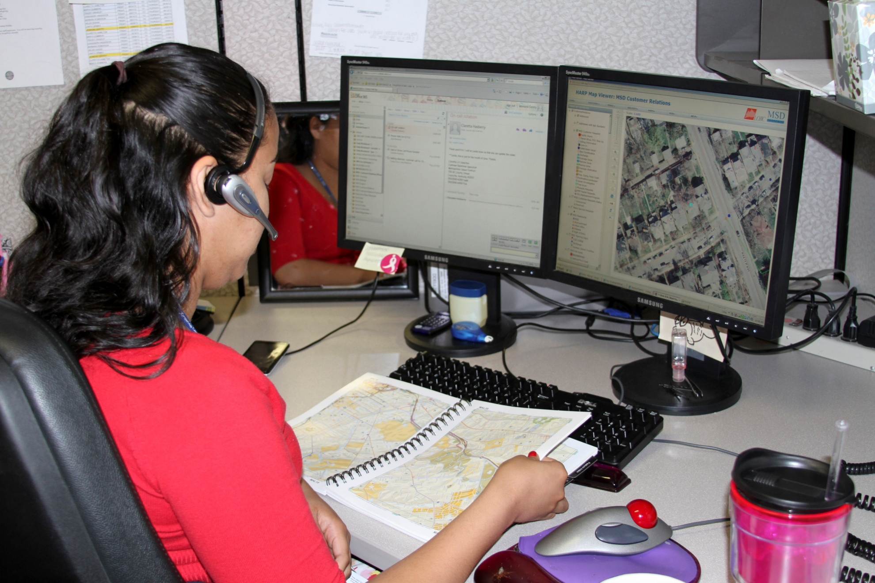
Co-workers use the LOJIC Map Book

Slide 4
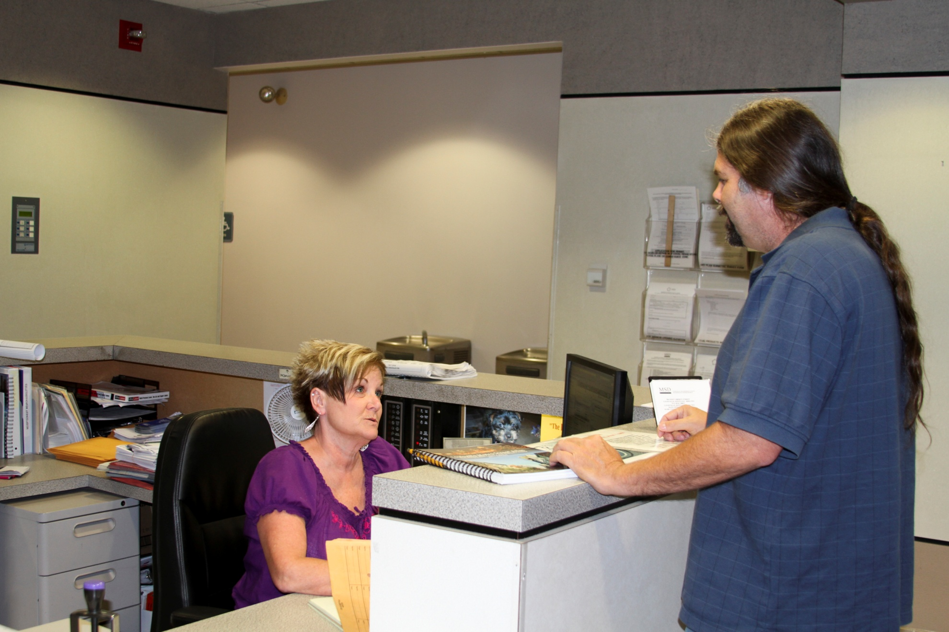
I work with a receptionist to keep appointments and walk-ins straight

Slide 5
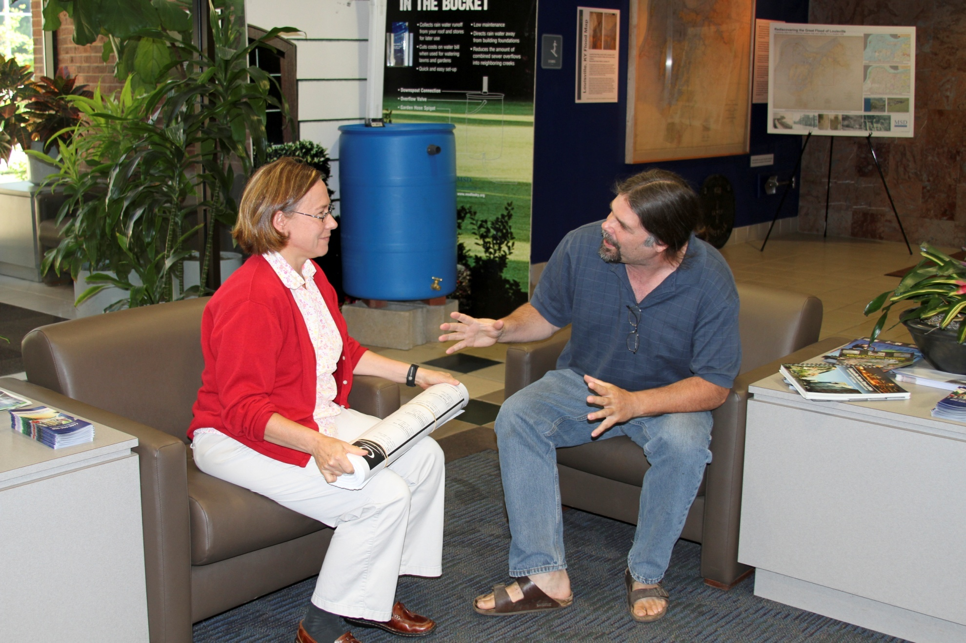
I solve as many problems in the lobby as possible

Slide 6
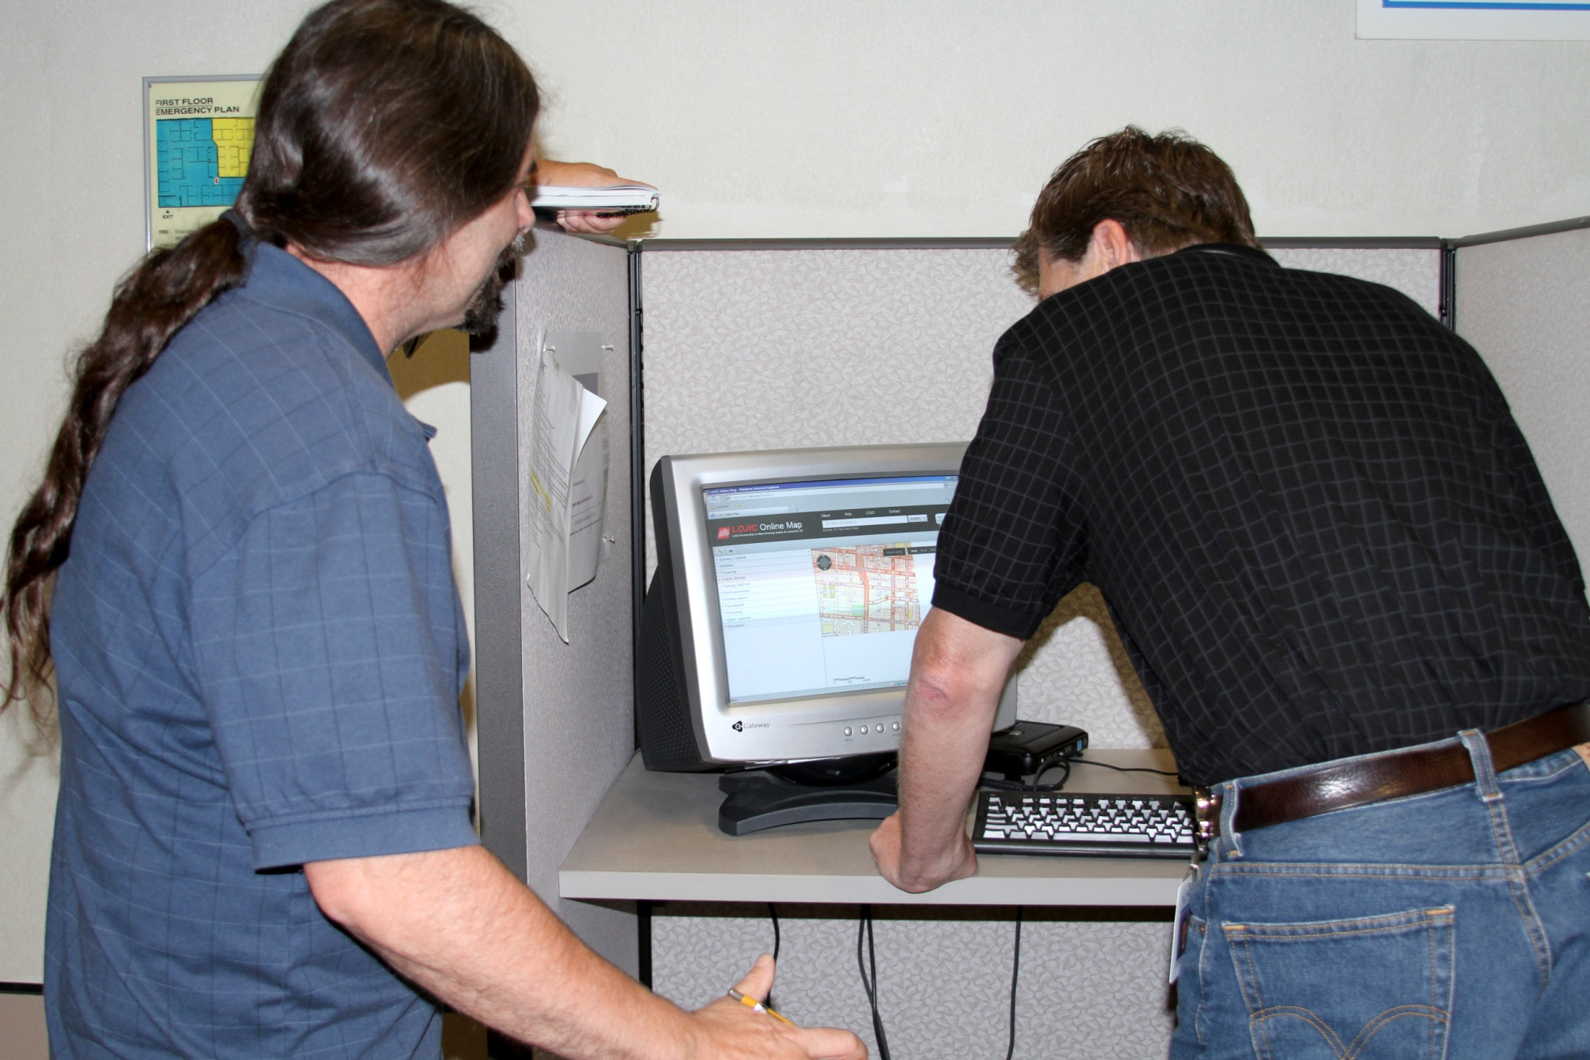
I use the lobby computers as often as possible

Slide 7
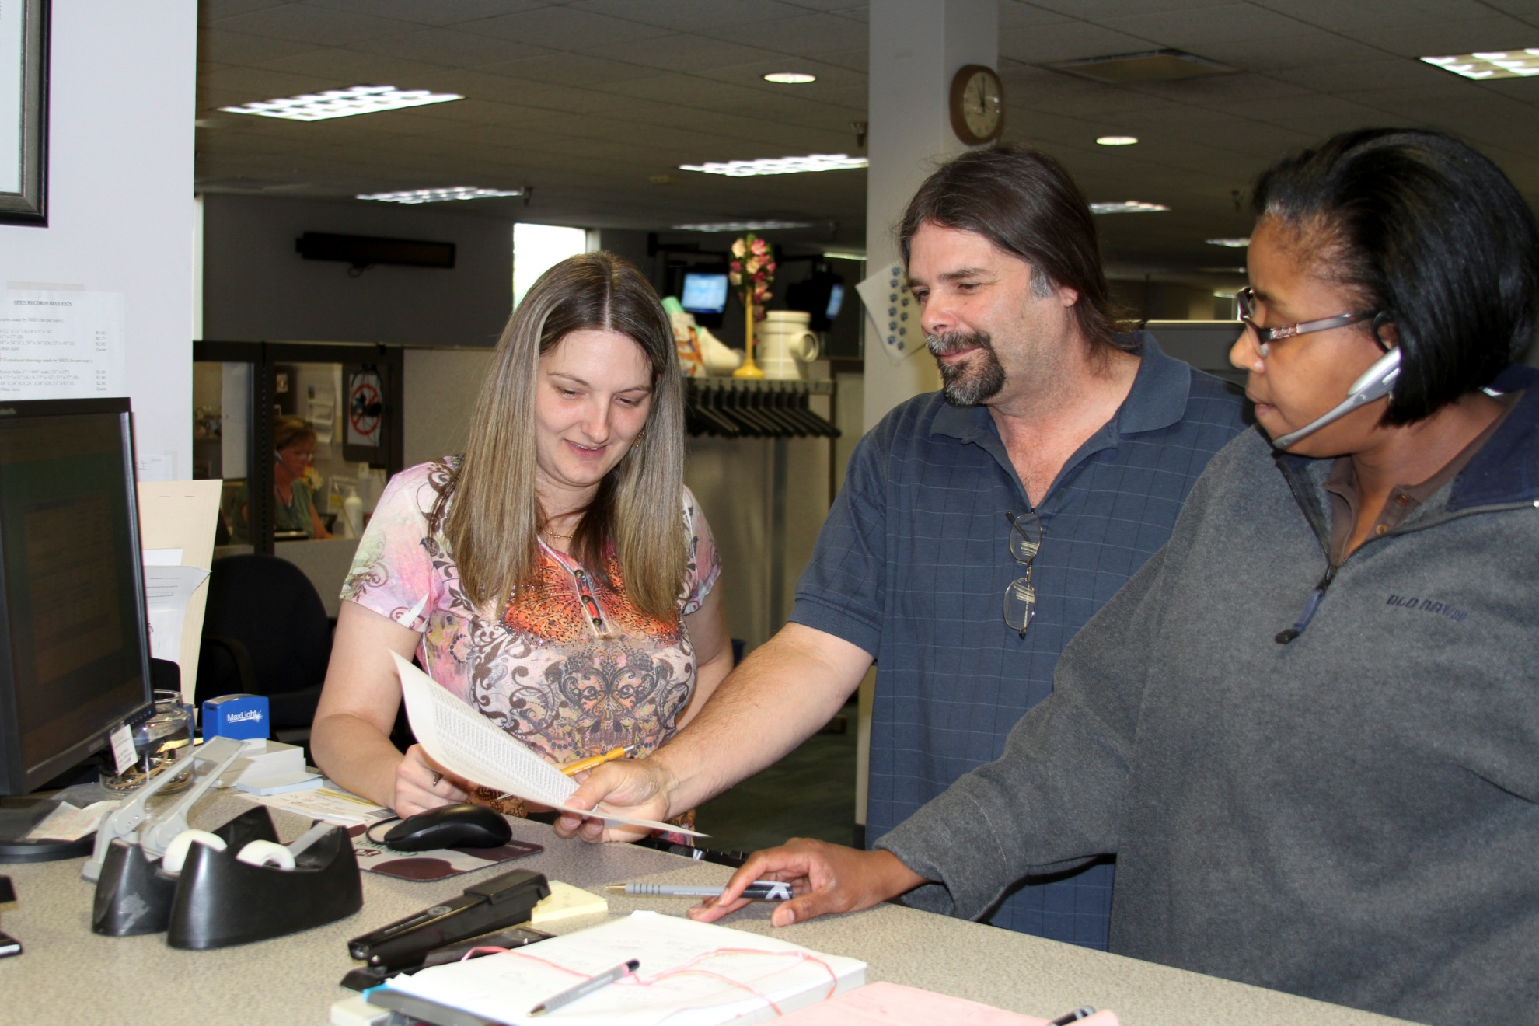
I work with MSD Customer Service

Slide 8
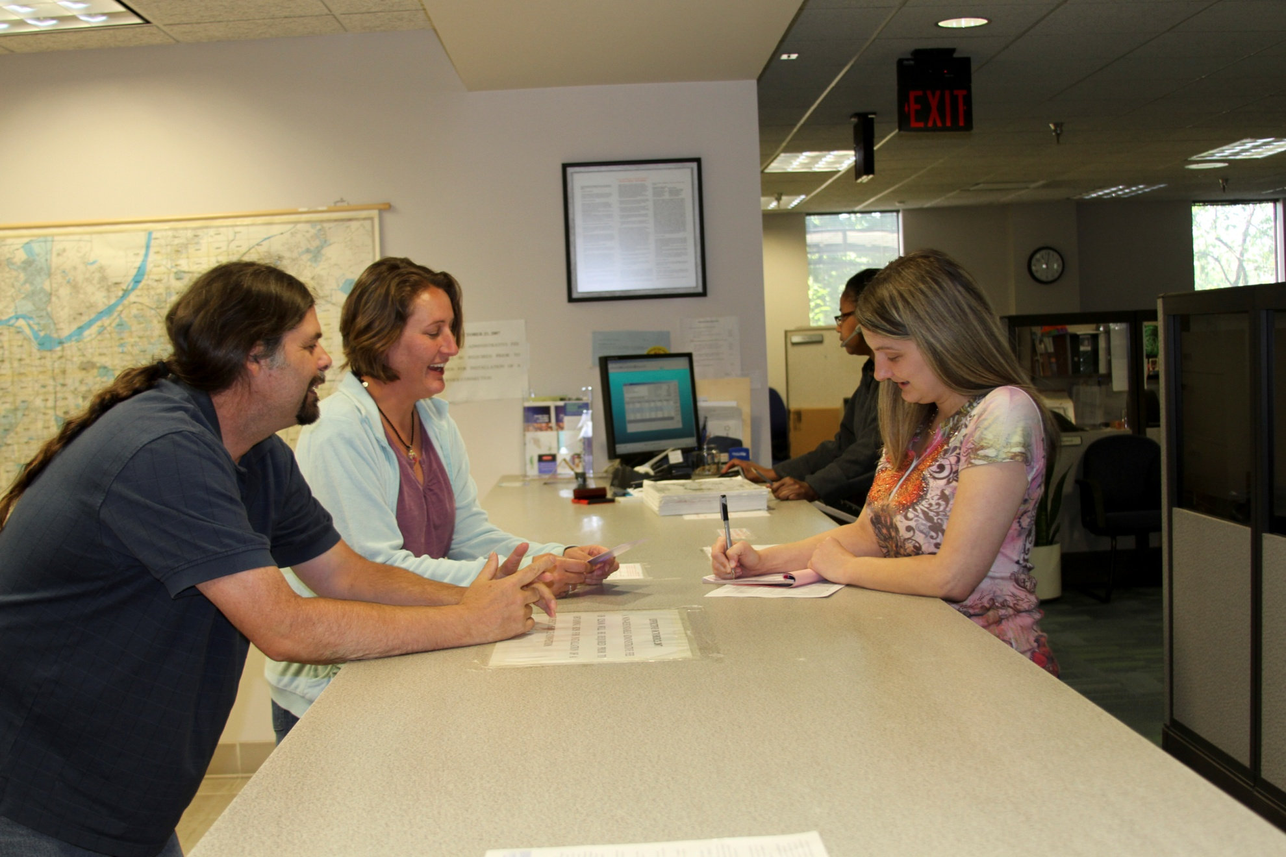
I work with MSD Customer Service on both sides of the counter

Slide 9
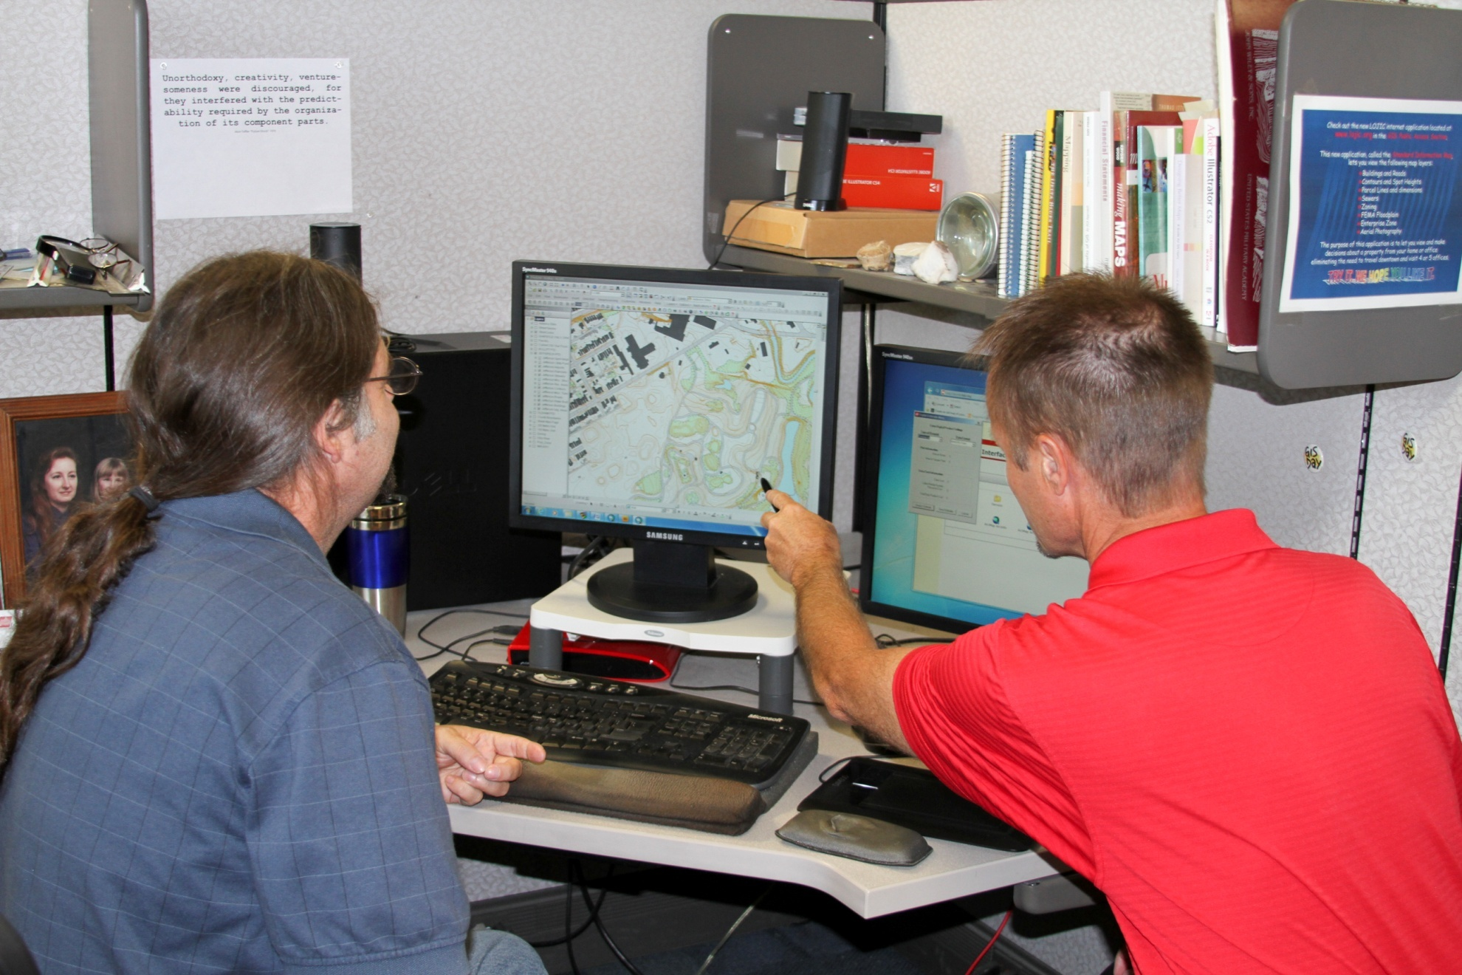
I sometimes work with customers with GIS in my cube

Slide 10
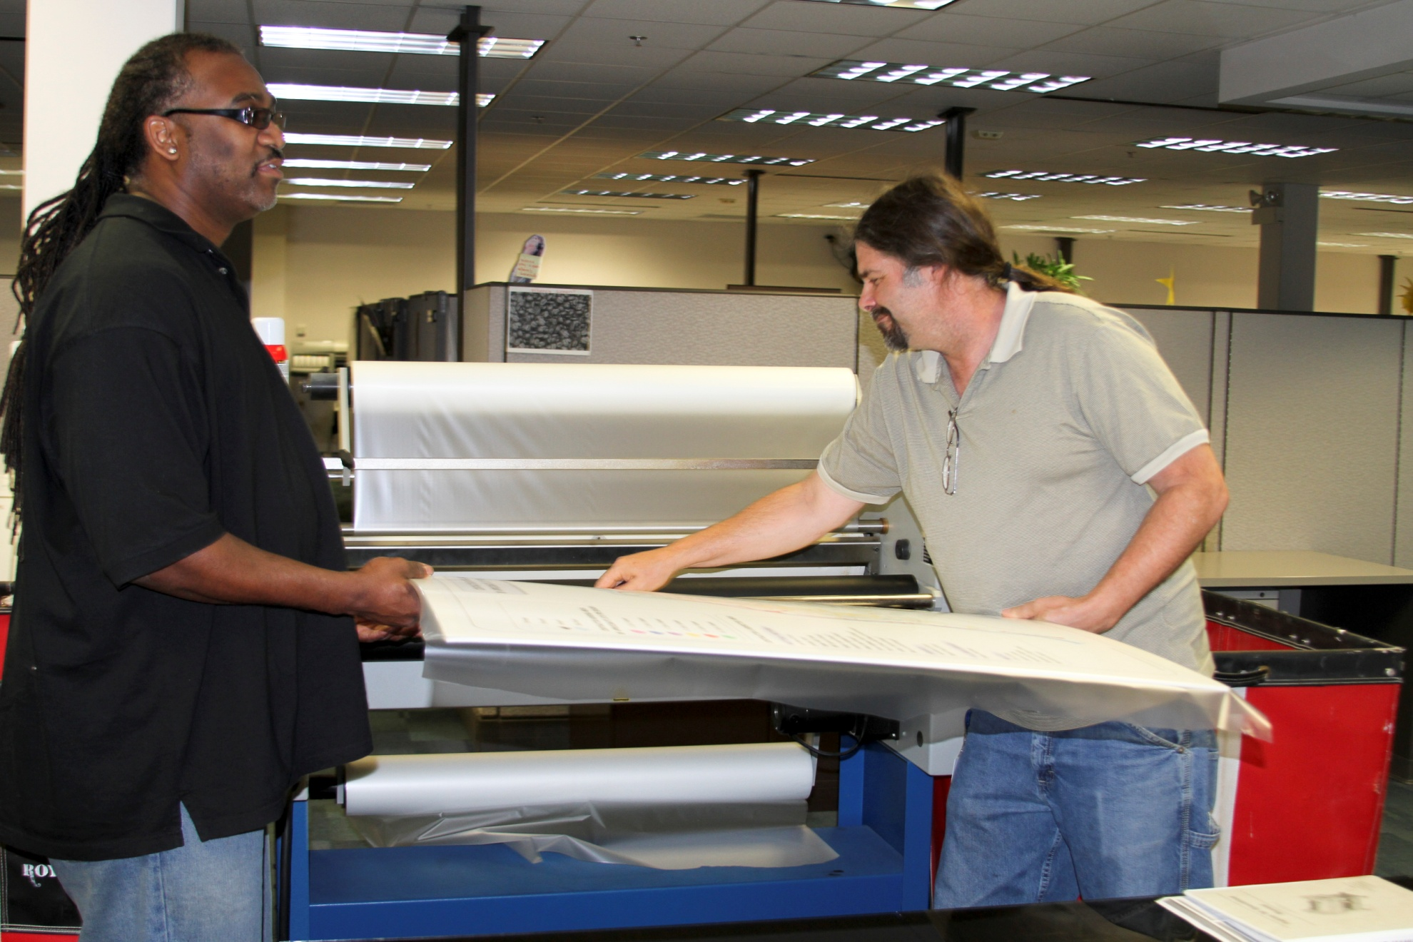
I work with GIS Jay to laminate and prepare work for presentation

Slide 11
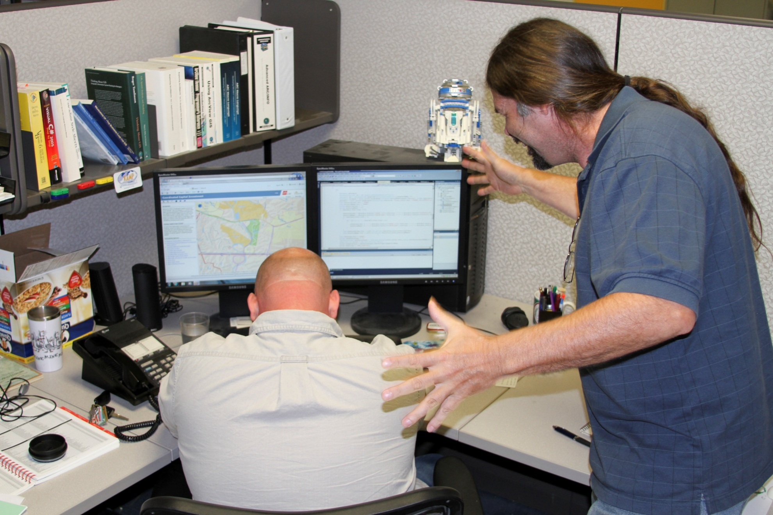
I am explaining how important the Customer is to the Programming Staff

Slide 12
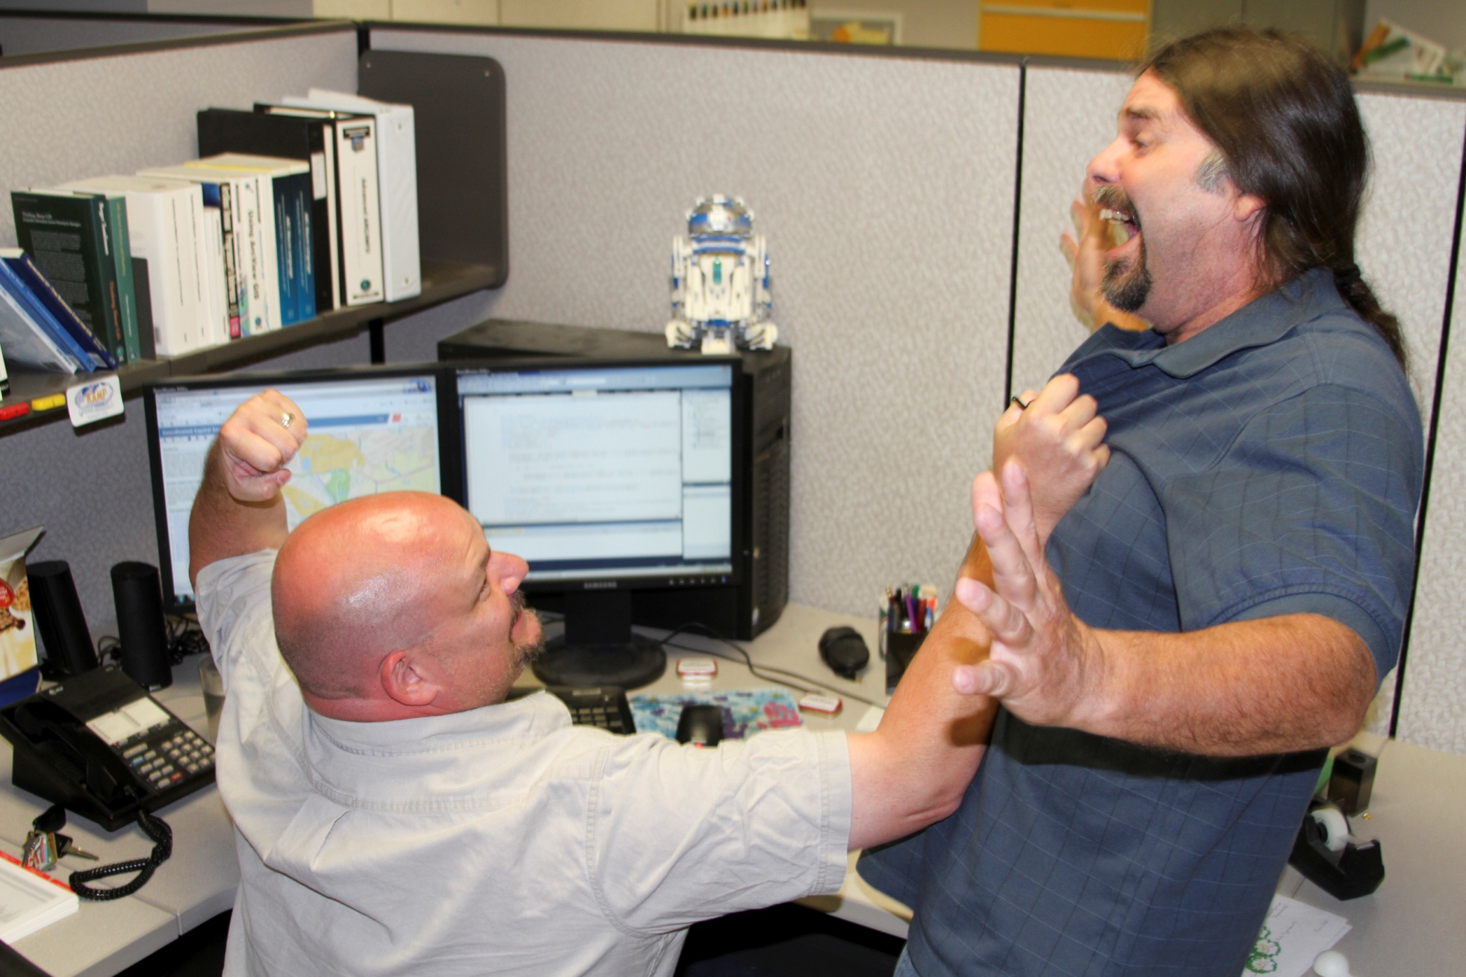
The programming staff is making a his point that the end user is often an idiot

Slide 13
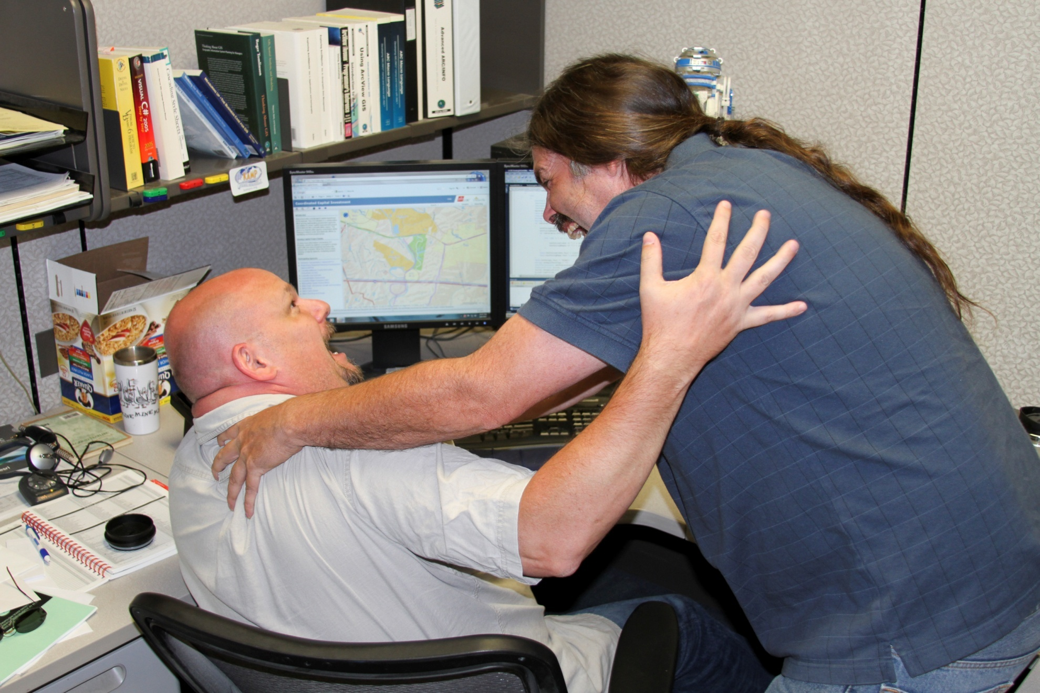
And of course we are congratulating each other on our understanding of the problem

Slide 14
Goals
What is the goal of the customer?
Do they want a map to decorate their room or office?
It could happen but most likely not. The customer usually has a problem they need solved and GIS data will help do it. Your goal is to find out what they are trying to accomplish and find the best and lowest cost product to reach their goal.

Slide 15
Responsibility
What is the level of responsibility for the person requesting the data to the project?
Are they a runner for someone else? Is this the property owner?
Finding out how much the person with the request cares about the project is of great value. If they are a warm body sent down to get a map, they often come back wanting what their boss really wanted. This can be avoided by calling the responsible party.

Slide 16
Attitude
What is the attitude of the customer? Are they angry, impatient, or in a good mood and who isn't all three of these when needing GIS data?
Often a new customer will be evasive in answering questions. The customer often is incorrectly informed about what LOJIC can do and will insist that the incorrect information is correct. Often the incorrect information has been given to the customer by another department that has a limited GIS understanding.

Slide 17
Behavior
How is a customer acting?
This is closely tied to attitude but a good indicator of how much time I will spend with a customer in the lobby versus in my workspace. A person may have a poor attitude but their behavior indicates they are not acting on it. The reverse is also true. There have been some very odd requests made by some very difficult people at the LOJIC products department. It is important to look out for ones own safety as well as the safety of co-workers.

Slide 18
G Goals
R Responsibility
A Attitude
B Behavior

