Slide 1
MAPPING THE LEWIS AND CLARK VOYAGE OF DISCOVERY’S EXPEDITION ROUTE MAY 21, 1804 THROUGH SEPTEMBER 23, 1806
KATHLEEN SMALUK-NIX (ksmaluknix0001@kctcs.edu)
GIS STUDENT
WITH THE GUIDANCE OF
PROFESSOR VINCENT A. DINOTO, JR
JEFFERSON COMMUNITY & TECHNICAL COLLEGE

Slide 2
ROUTE SEGMENTS
The entire journey from the Atlantic Ocean to the Pacific Ocean is broken down into three segments:
Planning/Preparation Route - In the summer or fall of 1802, President Jefferson told Meriwether Lewis, his secretary, that he would be in charge of the expedition to the Pacific Ocean. This continued through early July 1803.
Recruitment and Supply Route – Late July 1803 through December 1803. Late September 1803, Lewis visited Big Bone Lick, Kentucky to view a mammoth skeleton. In mid to late October 1803, Lewis and Clark spent 2 weeks in Clarksville, IN.
Expedition Route - The entire Expedition left St. Charles, Missouri on May 21, 1804. Two years, four months, and 10 days later, they returned to St. Louis, Missouri on September 23, 1806.

Slide 3
For this project’s focus, the Expedition Route was chosen because it just sounded like a fun project. It also presented challenges and resulted in a new respect for the people in the Expedition.
The Planning/Preparation Route and the Recruitment Route are reserved for another project.
Eventually, the three routes will be combined to reflect the full endeavor from late summer/early fall 1802 through September 1806. The goal is to put this on a geospatial server with a web interface.

Slide 4
The actual Expedition Route does not exist anymore. Campsite locations are approximate. In addition to the natural changes in flow of the rivers/creeks, there are
14 dams for power-generation and flood control block the Upper Missouri River,
4 block the Snake River,
3 block the Columbia River.
Cities/towns and other manmade structures (roads, reservoirs, buildings, parks and their trails and structures, etc.) have also covered the actual Lewis and Clark Trail. There are, however, a plethora of maps that closely approximate the Lewis and Clark Trail and their campsites.
Oh, the joys of searching for and sifting through information.
So far, this project has consumed 38.6 GB.
Notes:
Encountering Murphy’s Laws!!!!!

Slide 5
EXPEDITION ROUTE
All resources agreed on their general route of journey to the west and back to the east:
Traveled by boat up the Missouri River from its mouth on the Mississippi River.
Portaged around five falls (now in Great Falls, Montana),
Continued to the Missouri River’s headwaters.
Traveled through the Rocky Mountains.
Followed the Columbia River to the Pacific Ocean.
Traveling back east up the Columbia river.
Notes:
add map

Slide 6
EXPEDITION ROUTE (continued)
Through the Rocky Mountains, they broke into three different groups. Lewis’s group traveled northeast. Clark’s group and Sergeant John Ordway’s group canoed together down smaller rivers to the headwaters of the Missouri. Sergeant John Ordway’s group then continued down the Missouri River (including another portage around the five falls). Clark’s group followed smaller rivers southeast to the Yellowstone River which eventually flowed into the Missouri River.
The three parties joined back together where the Yellowstone and the Missouri Rivers merge (in North Dakota), and finally
Retraced their route along the Missouri River back to St. Louis, Missouri.

Slide 7
Using on-line resources, identified the individual states and merged into one polygon shapefile. Merged the counties of each state into one polygon shapefile

Slide 8
To get the Missouri River in each state:
1 - Downloaded the zipped files for a county’s area hydrography from the Census Bureau and extracted the data.
2- By state, merged the counties’ area hydrography shapefiles into one shapefile for the state’s area hydrology.

Slide 9
To get the Missouri River in each state (continued)
3 - One state at a time, turned on the layer for a state’s area hydrography . From the attribute table, selected those attributes belonging to the Missouri River. Identified segments belonging to the lakes through which the river flowed. For each state, exported selected attributes into one shapefile.
Kansas

Slide 10
Missouri River
Within each state’s area hydrography, identified the Missouri River.
Merged all the merged shapefiles to form one shapefile for the Missouri River

Slide 11
Followed the same procedure to identify the full length of the Columbia River.
Notes:
This is not their path.

Slide 12
More data was needed for the Rocky Mountains.

Slide 13
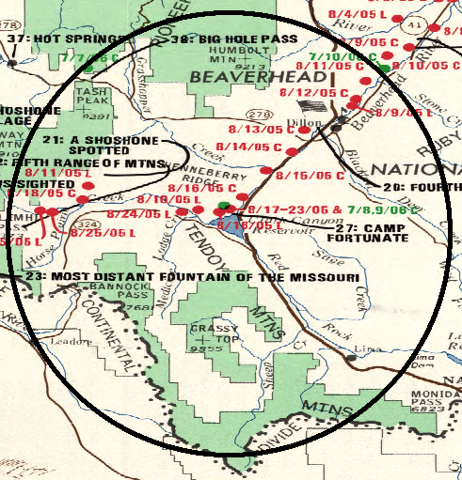
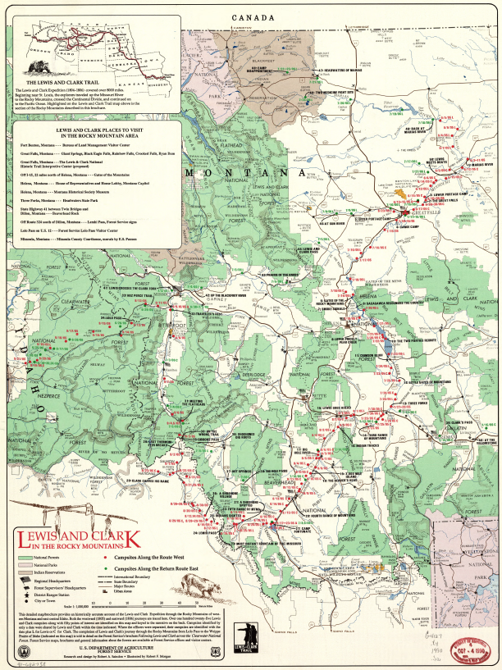
Georeferenced the map Lewis and Clark Through the Rocky Mountains.
The zoomed area around
Clark Canyon Reservoir.

Slide 14
Selected the counties involved in the Expedition Route through the Rocky Mountains. Exported into one shapefile.

Slide 15
Added both Area and Linear Hydrography for the counties in the Rocky Mountains.
Area Hydrography
Area and Linear Hydrography

Slide 16
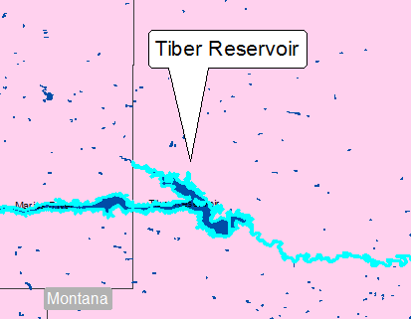
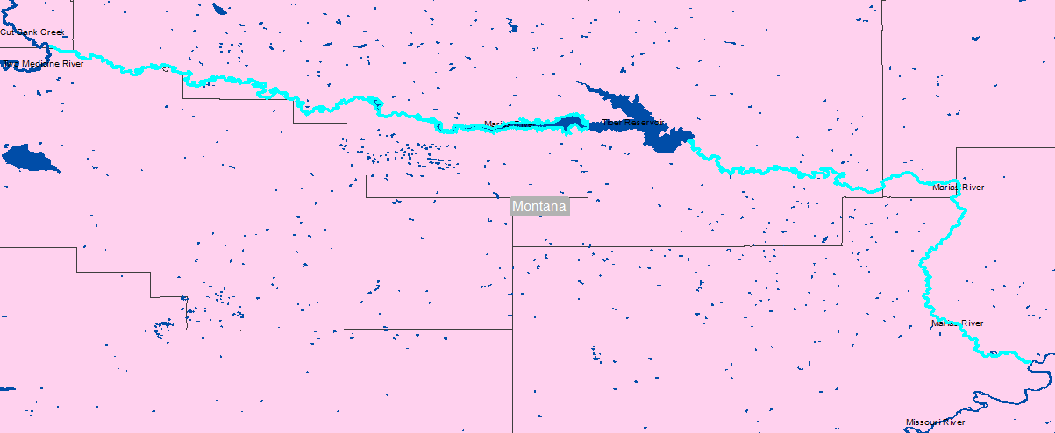
IDENTIFING INDIVIDUAL RIVERS IN AREA HYDROGRAPHY
Marias River flows through the Tiber Reservoir.
Marias River is 210 miles long
Notes:
Marias river was spelled maria’s river.

Slide 17
The Marias River
Exported all those selected segments to one shapefile.
The same procedure was used to identify the smaller rivers in the Expedition Route.

Slide 18
Turned on the Area Hydrography then Linear Hydrography in order to identify the missing segments of a river.
Here, the East Gallatin River is used as an example
Notes:
Linear hydrography

Slide 19
For the missing section, opened the attribute table for the Linear Hydrography and chose the ‘EAST GALLATIN RIV’.
Used the identify tool to identify another missing section. The spelling was slightly different-
‘E GALLATIN RIV’.

Slide 20
Exported selections for both river names to create one line shapefile for the East Gallatin River.
Only by turning on both the Area and the Linear Hydrography shapefiles can the entire East Gallatin be seen.

Slide 21
Followed the same procedure to identify the missing sections of the other rivers in the Rocky Mountains.
Merged all individual river’s linear hydrography shapefiles into one shapefile.

Slide 22
Waterways of the Corps of Discovery
Notes:
Did not travel entire waterway – only some portions appear to connect because of being zoomed out

Slide 23
IDENTIFYING THE SITES
Created a point shapefile to capture the information from 26 georeferenced maps and various articles.
The attribute tables has columns for
name of camper (Lewis, Clark, or Lewis and Clark)
Direction (west or east)
Waterway
Date or dates
Site name if any
Type – Campsite or Point of Interest

Slide 24
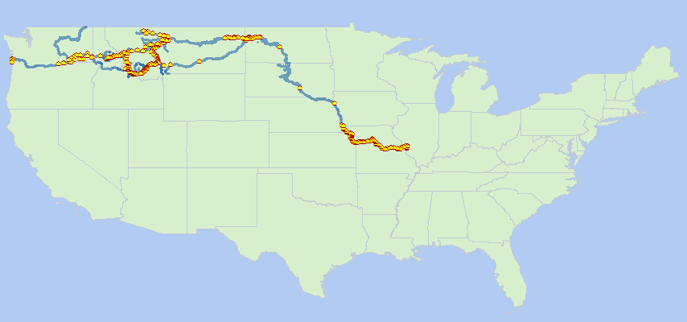
Notes:
264 campsites were identified

Slide 25
PORTAGE
To identify the five falls along the Missouri River (now Great Falls, Montana), georeferenced a map from the National Parks Service. Captured the information in a polyline shapefile.

Slide 26
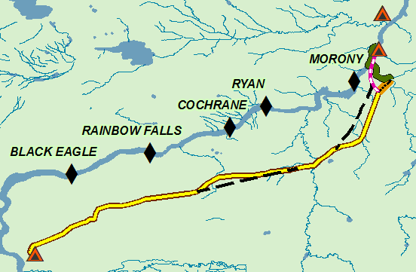
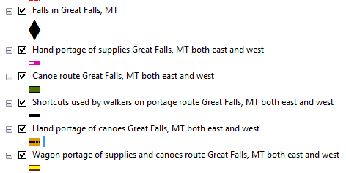

Slide 27
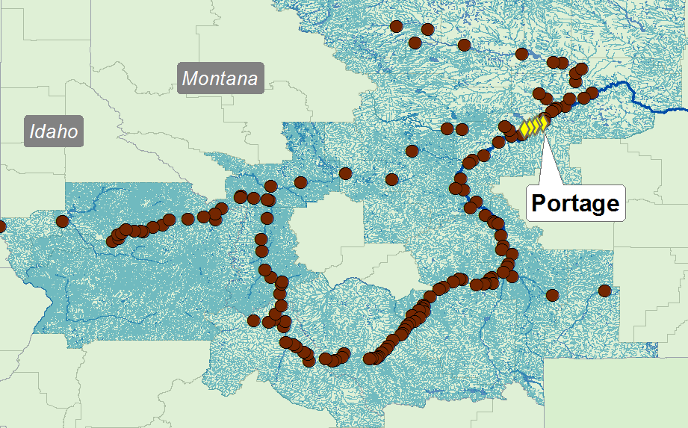
CAMPSITES IN THE ROCKY MOUNTAINS
Notes:
Some east some west directions – not just one way

Slide 28
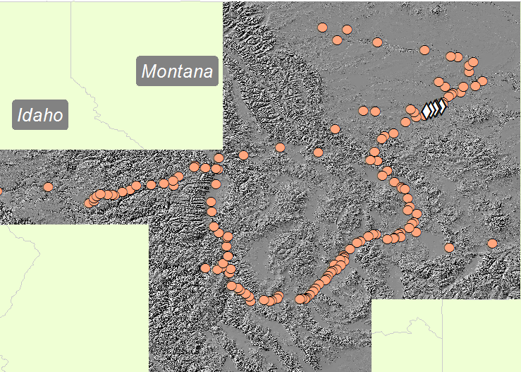
HILLSHADE
23 rasters were mosaicked to show the terrain in the Rocky Mountains.

Slide 29
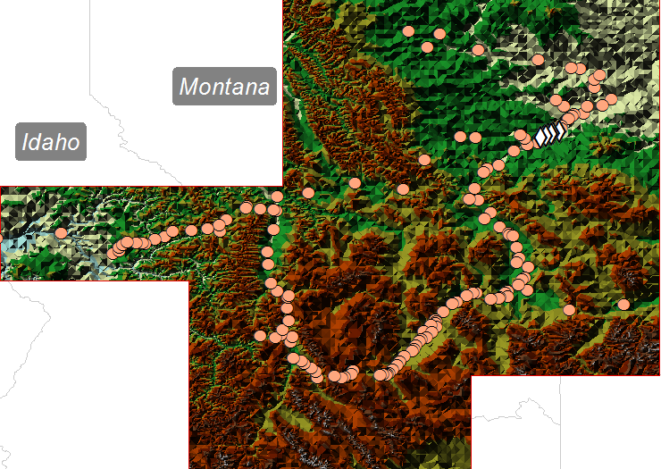
TIN

Slide 30
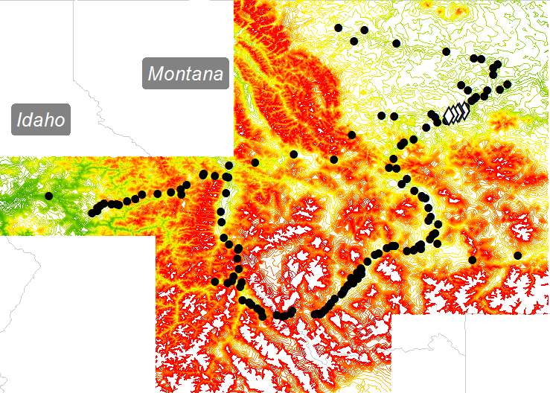
CONTOUR
50 Intervals, 14 Classifications

Slide 31
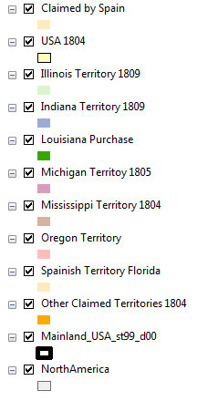
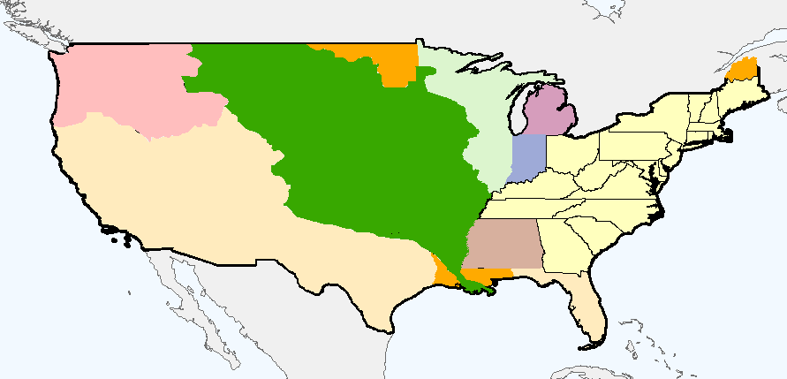
UNITES STATES AND TERRITORIES 1804-1809

Slide 32
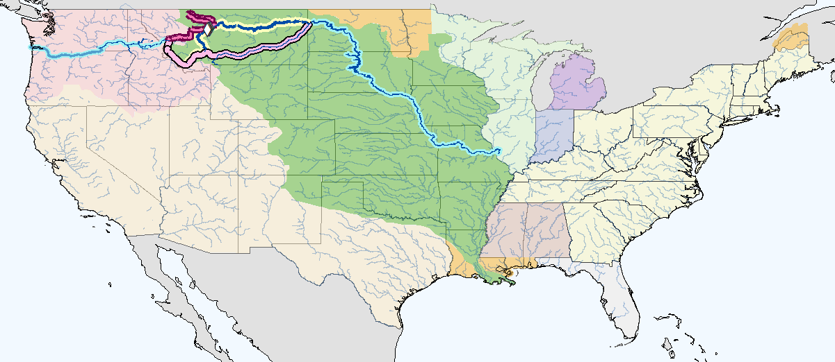
Corps of Discovery West and East

Slide 33
RESOURCES
Civics_Online.org
Library of Congress
National Park Service
National Geographic
National Registry of Historic Places
National Weather Service
MinotLibrary.org
University of Virginia library
USGS
U. S. Department of Agriculture
DEDICATED LEWIS AND CLARK SITES
LewisAndClarkTrail.com
LewisAndClark.com
LewisClark.net
LewisAndClark.org
Lewis-Clark.org
BOOKS
Undaunted Courage by Steven E. Ambrose
The Journals of the Lewis and Clark Expedition 13 volumes University of Nebraska-Lincoln Gary E. Moulton, Editor

