Slide 1

Data Extraction Using Aerial Imagery: Not Just a Pretty Picture
Mapping Wildlife Habitat and Identifying Evergreen Forest with ArcGIS Spatial Analyst.
M. Keith Wethington
Fish & Wildlife Information System
Kentucky Department of Fish & Wildlife Resources
Daniel Vichitbandha
Gary Sprandel
Tammi Johnson

Slide 3
Background/Problem
Quail research project involving KDFWR and University of Tennessee at Peabody WMA.
Request for ¼ acre resolution habitat mapping.
Patch size threshold for importance to quail habitat needs.
Roughly 1:2,500 scale.
Previous hand digitized maps at 1:8000 not sufficient.

Slide 4
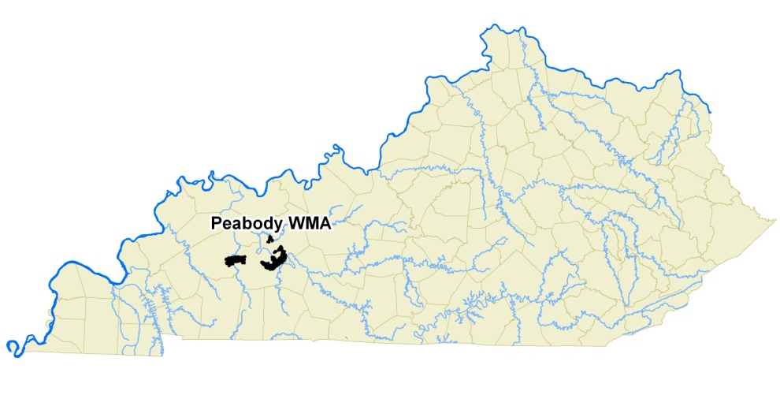
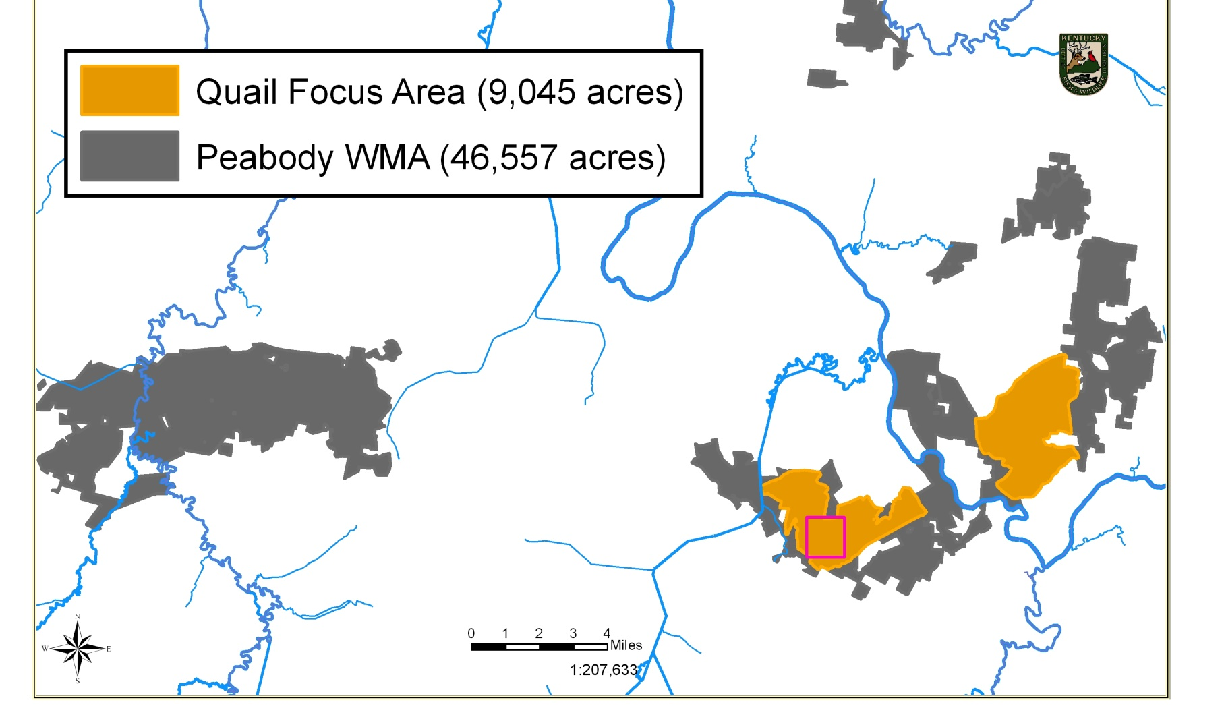

Slide 5
Challenges:
Short time frame (1 month)
Staff on other projects
Staff ability to photo interpret habitat types accurately
Large area (9,000 Acres)
Reclaimed surface mine, normal vegetation rules don’t apply
Difficult to differentiate ‘trees’ from ‘shrubs’
Topography altered, no elevation models

Slide 6
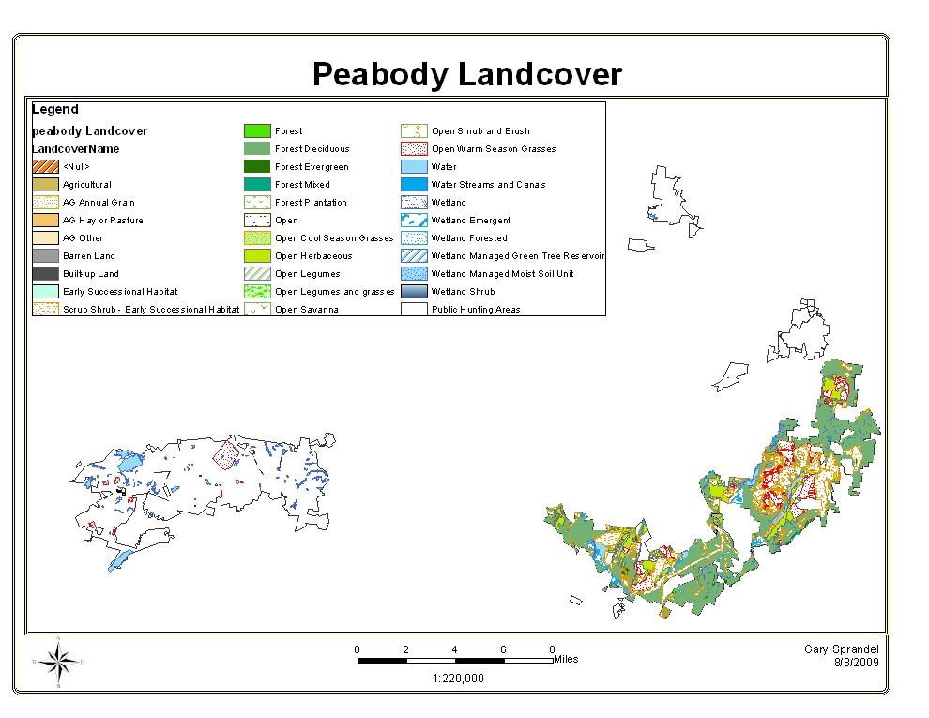
Digitized at 1:8,000

Slide 7
Approach:
Utilize existing high quality recent photography (2010 NAIP)
Use Image Analyst to allow software identification of Woody Vs Open habitat.
Create continuous raster dataset
  not discrete polygons of scrub-shrub/forest/and open lands
Generate raster dataset of woody and open pixels

Slide 8
Methods:
Used Model Builder and Image Analyst
Identified and removed known features such as water, roads, developed areas.
Established ‘training sites’ for woody and open habitat
Multiple iterations that refined training sites
Used ‘Aggregate’ function to generate continuous data set

Slide 9
Model Builder

Slide 10
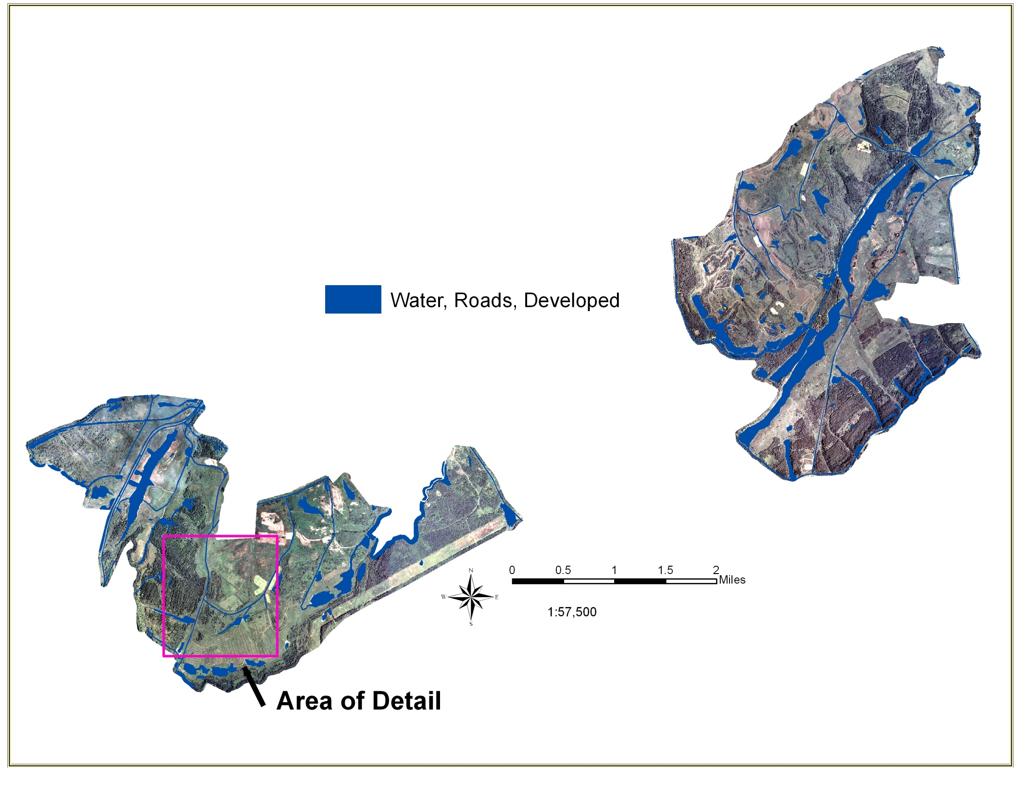
Clipped Aerial Photography

Slide 11
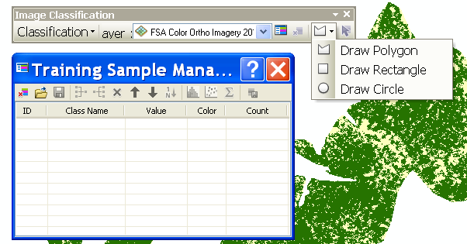
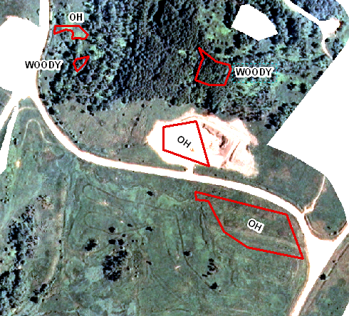
Image Analyst Extension for ArcGIS
Requires ArcInfo license and Spatial Analyst Extension
Establish ‘training’ sites within imagery

Slide 12
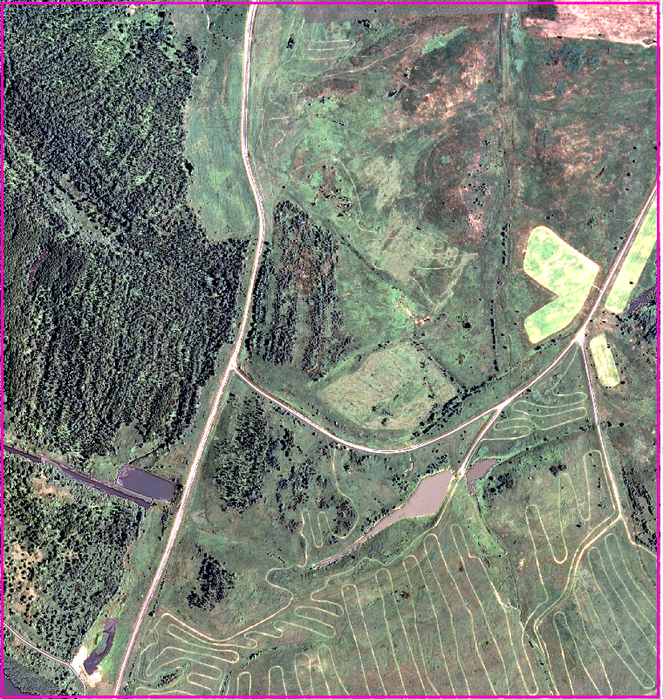
2010 NAIP Imagery
1 meter resolution

Slide 13
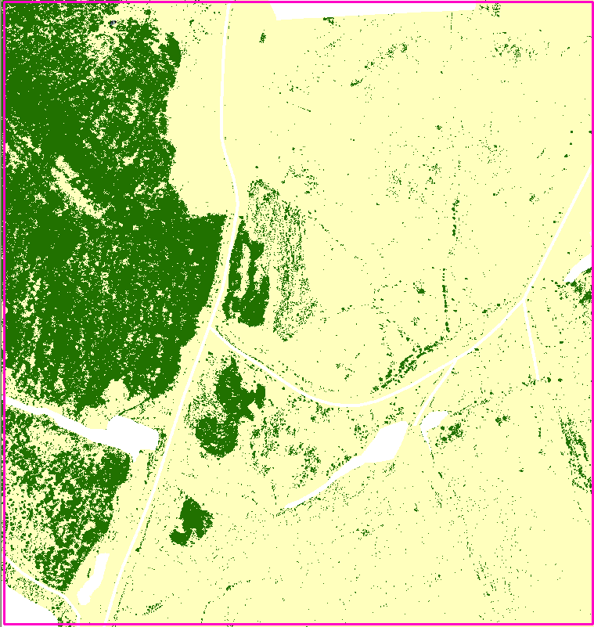
Interactive Supervised Classification
Woody value 1, Open value 0
Discrete raster data set

Slide 14
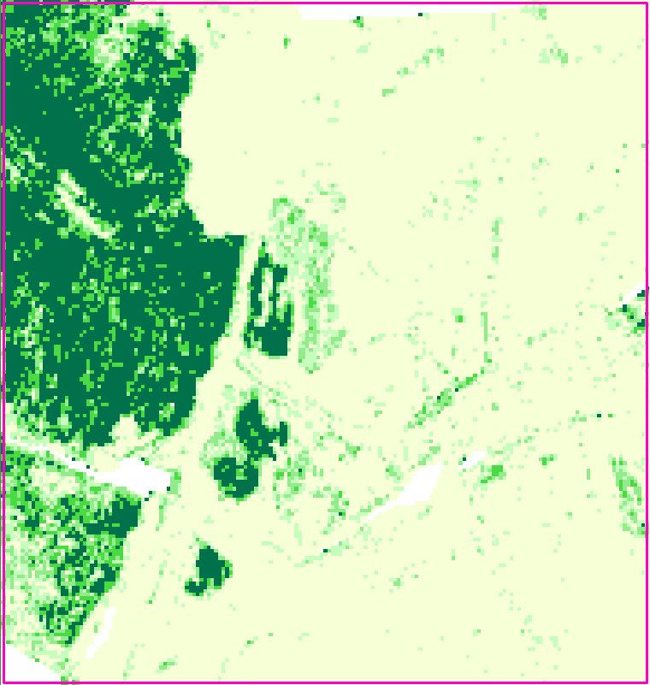
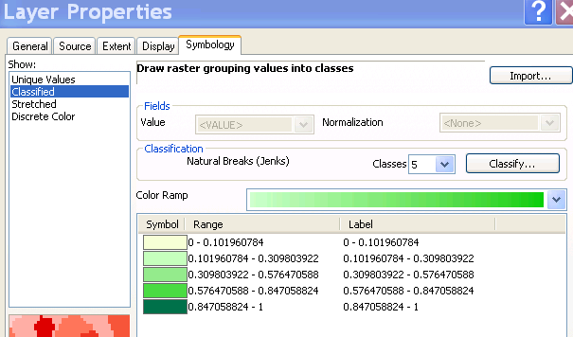
Aggregate combines 1m pixels into 10m pixels. Each 10m pixel is the ‘mean’ of the 100 input pixels.
Pixel values range from 0-100. Continuous raster data set

Slide 15
Classification
Used Jenks Natural Breaks with 5 classes
(0 to 0.1) open habitat
(.847 to 1) forested
Classes in between ecologically scrub-shrub?
Species found there might be typical of a forest
Not functioning as forest on the landscape.
Where to define line between forest-shrub-open ecotone (edge)?

Slide 16
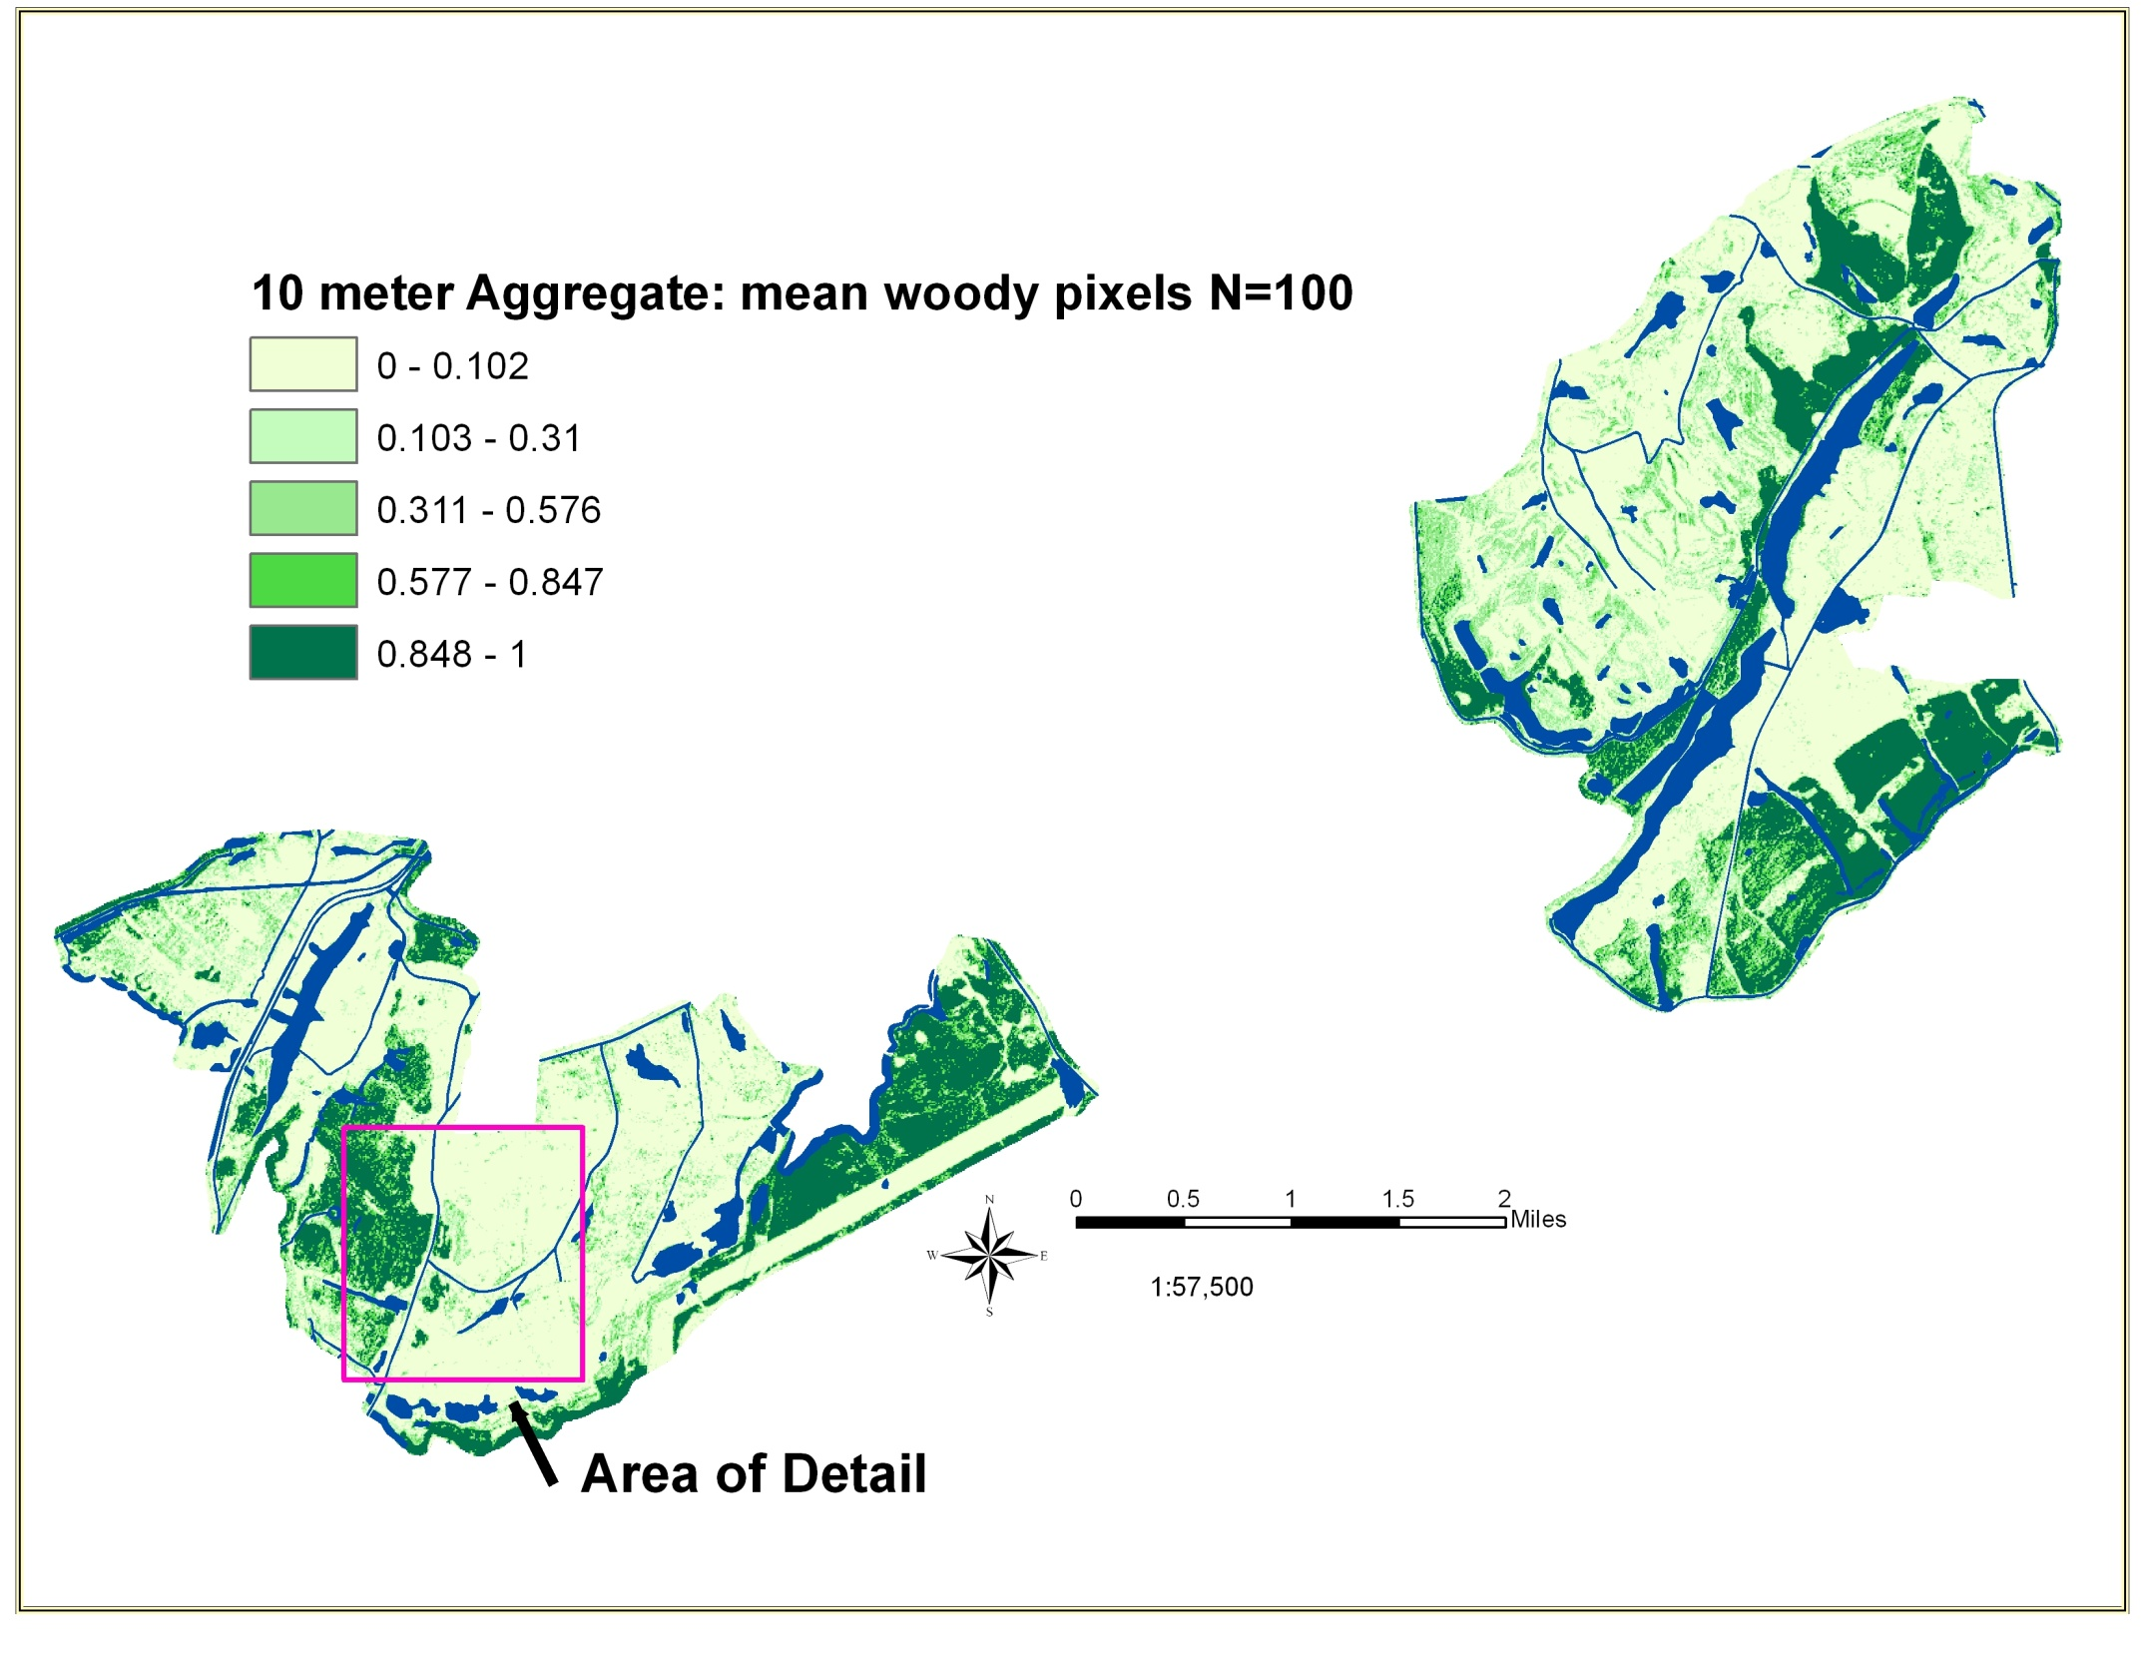

Slide 17
Advantages
Currency (2010 imagery)
Precision (1 meter)
Allows raster analysis, nearest neighbor, etc
Scalable. Aggregate function allows any pixel size
Disadvantages
Complex procedure
Model Builder useful but can’t capture all steps (e.g., functions on toolbar)
Large files sizes
ArcGIS not a ‘raster friendly’ environment

Slide 18
Conclusions
Augments human eye digitizing
  Still requires human inspection (we still matter!!)
  Removing roads and water is a manual process
  Software often confuses water and forest
Very sensitive to imagery quality
  Smoke from Paradise coal plant, clouds, etc
Capable of mapping woody vs. open habitat over large areas
Depending on research need can be overkill
  (1 meter resolution)
Potential for mapping cedar with leaf off imagery

Slide 19
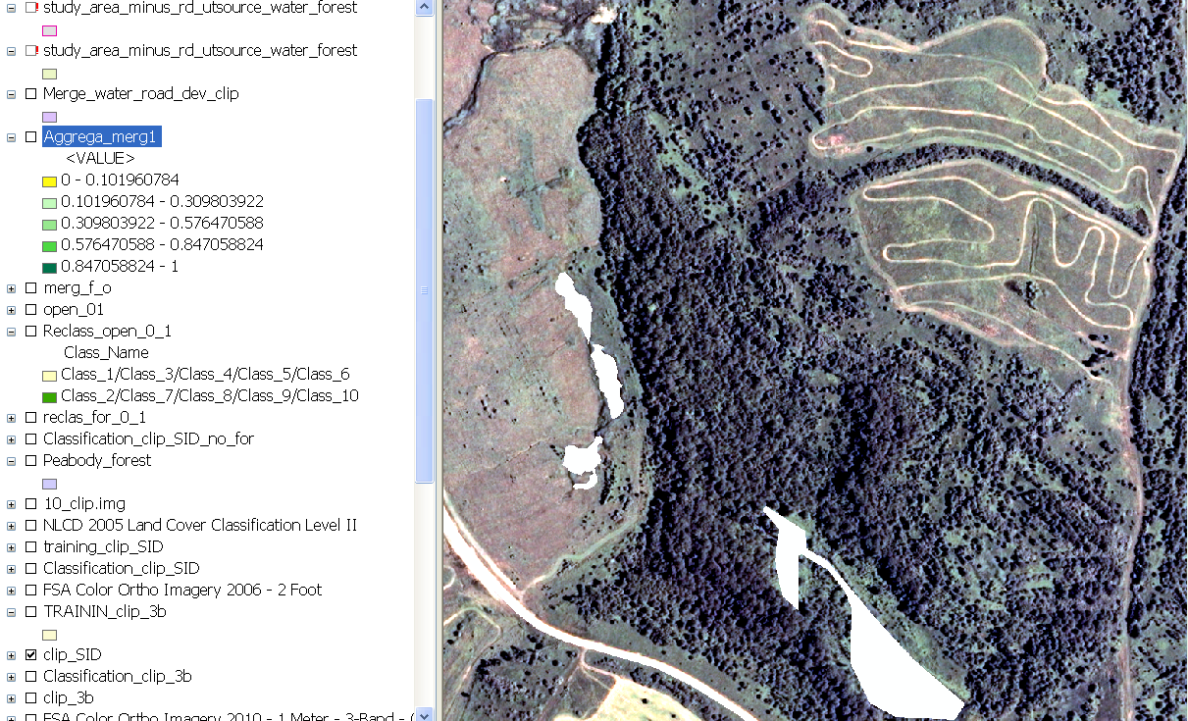
Peabody Ken Mine Site

Slide 20
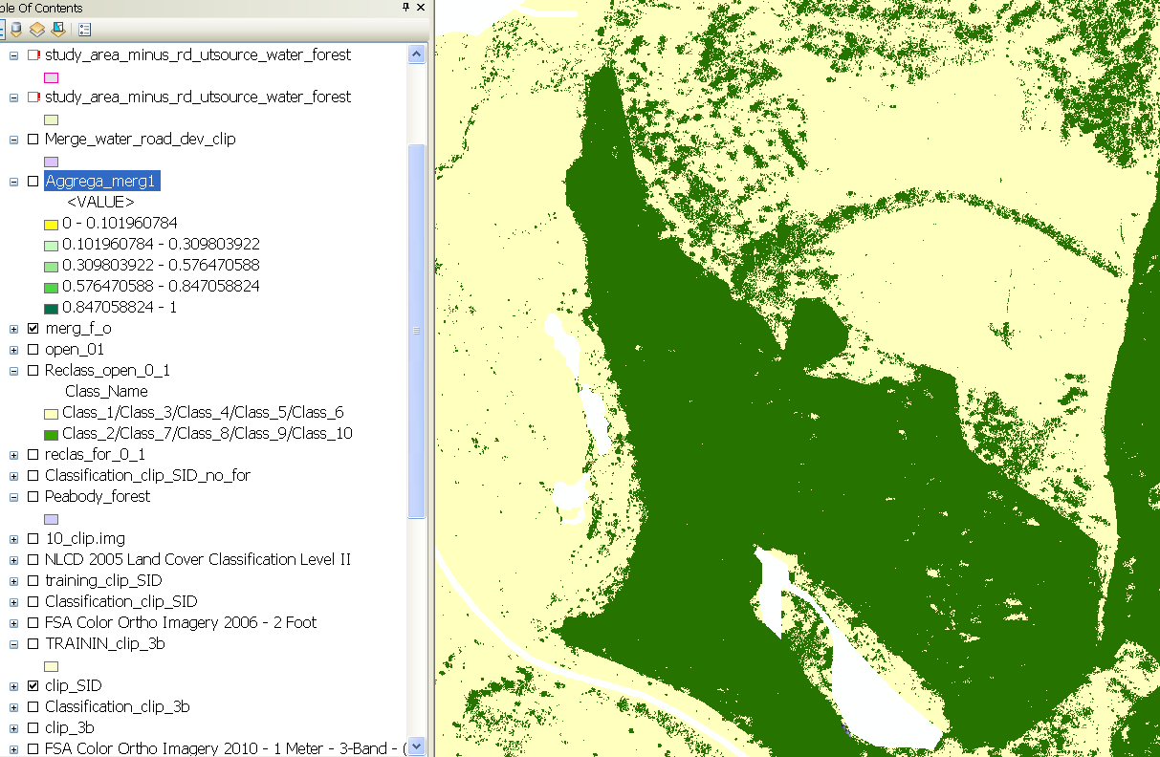
1 meter initial classification

Slide 21
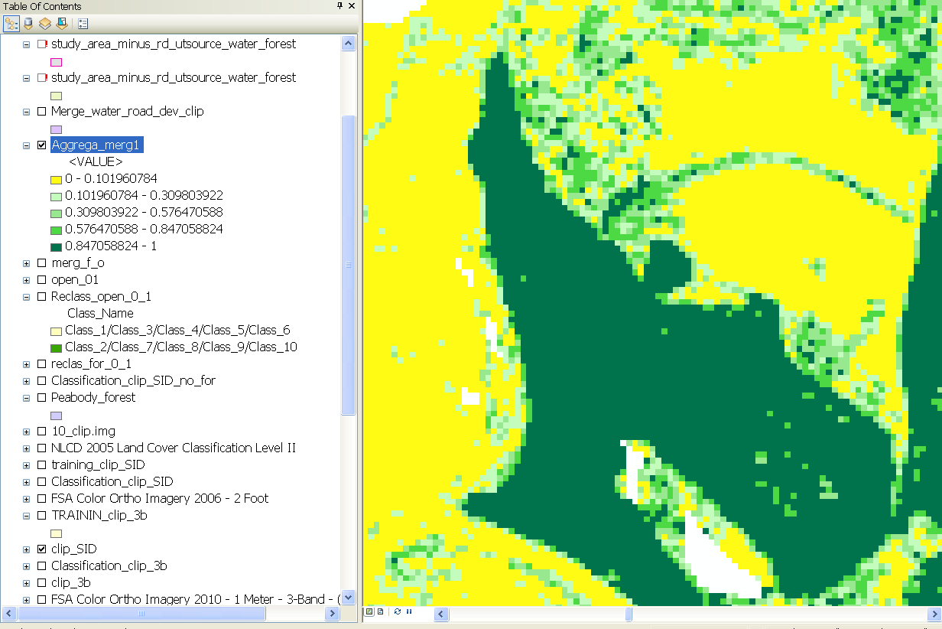
10 meter aggregation

Slide 22
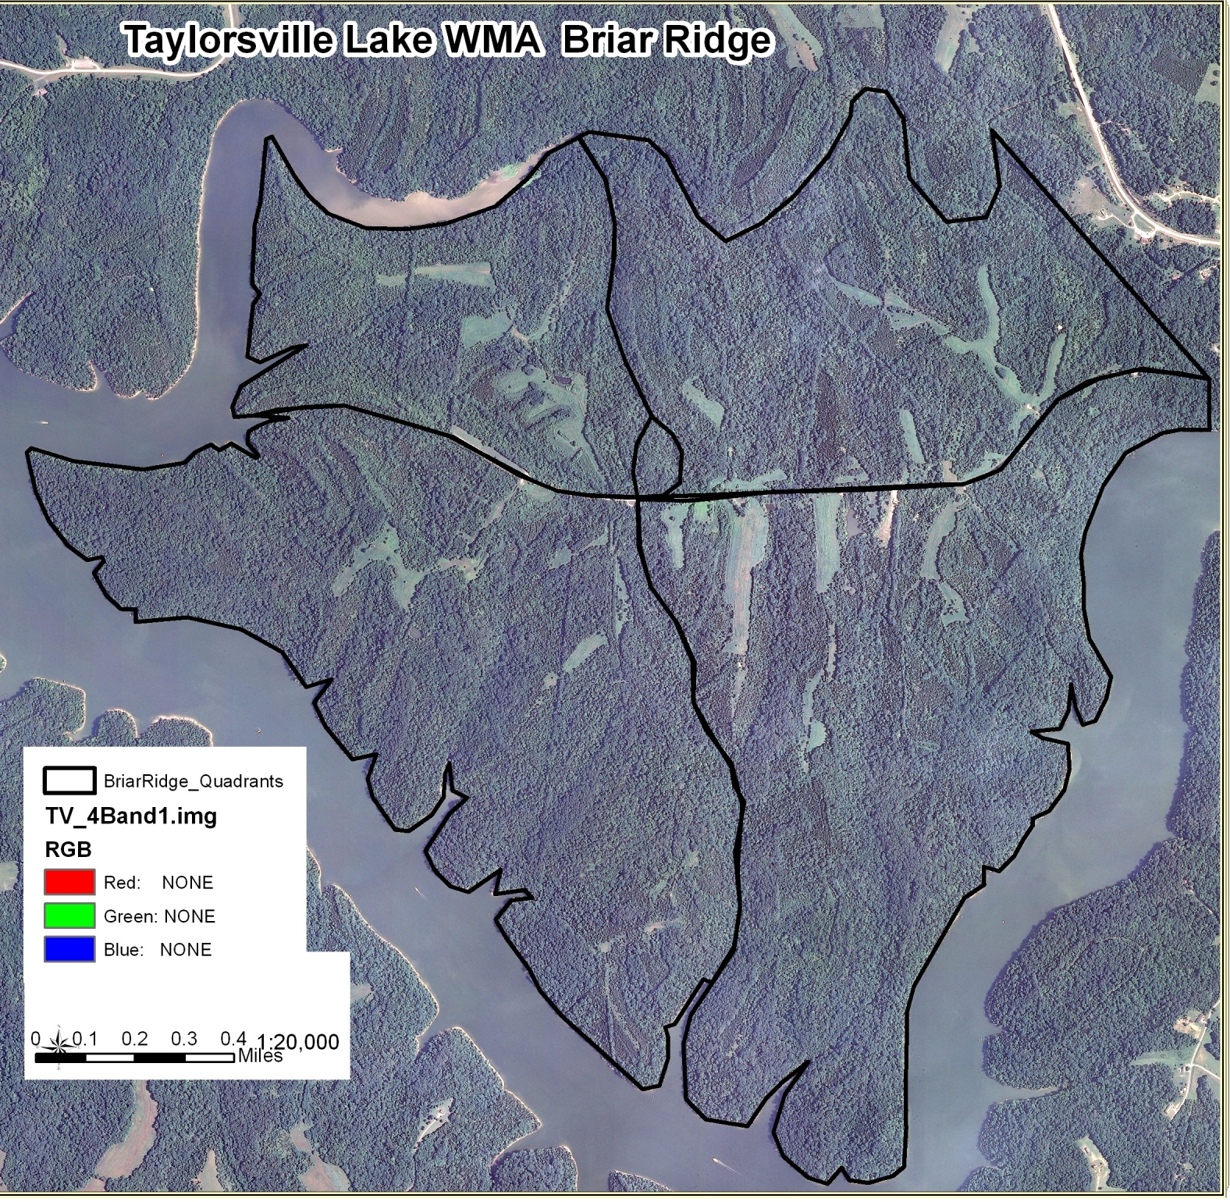
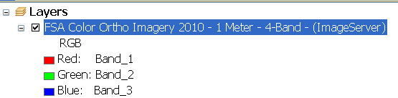
Identifying Cedar

Slide 23
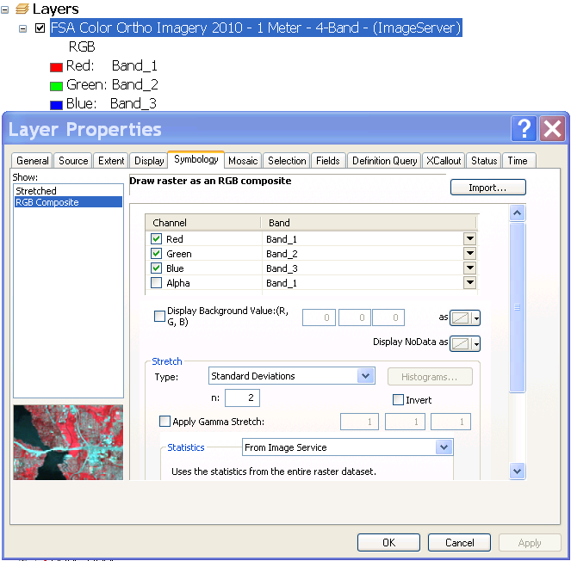

Slide 24
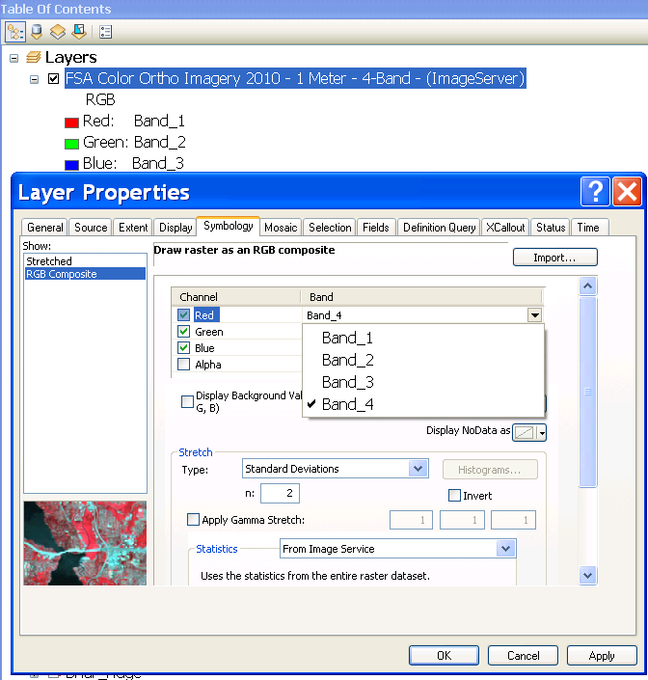

Slide 25
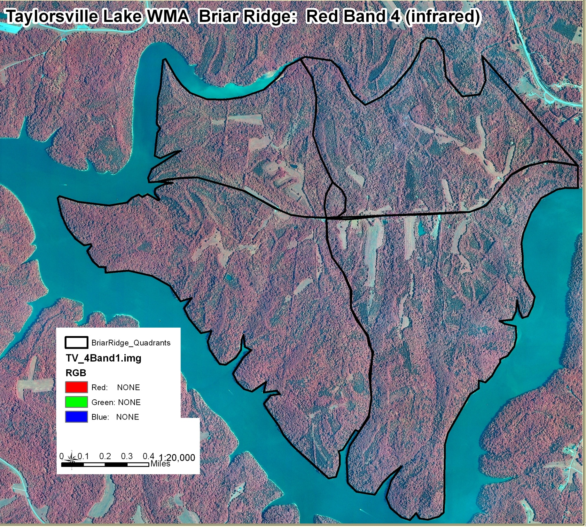

Slide 26
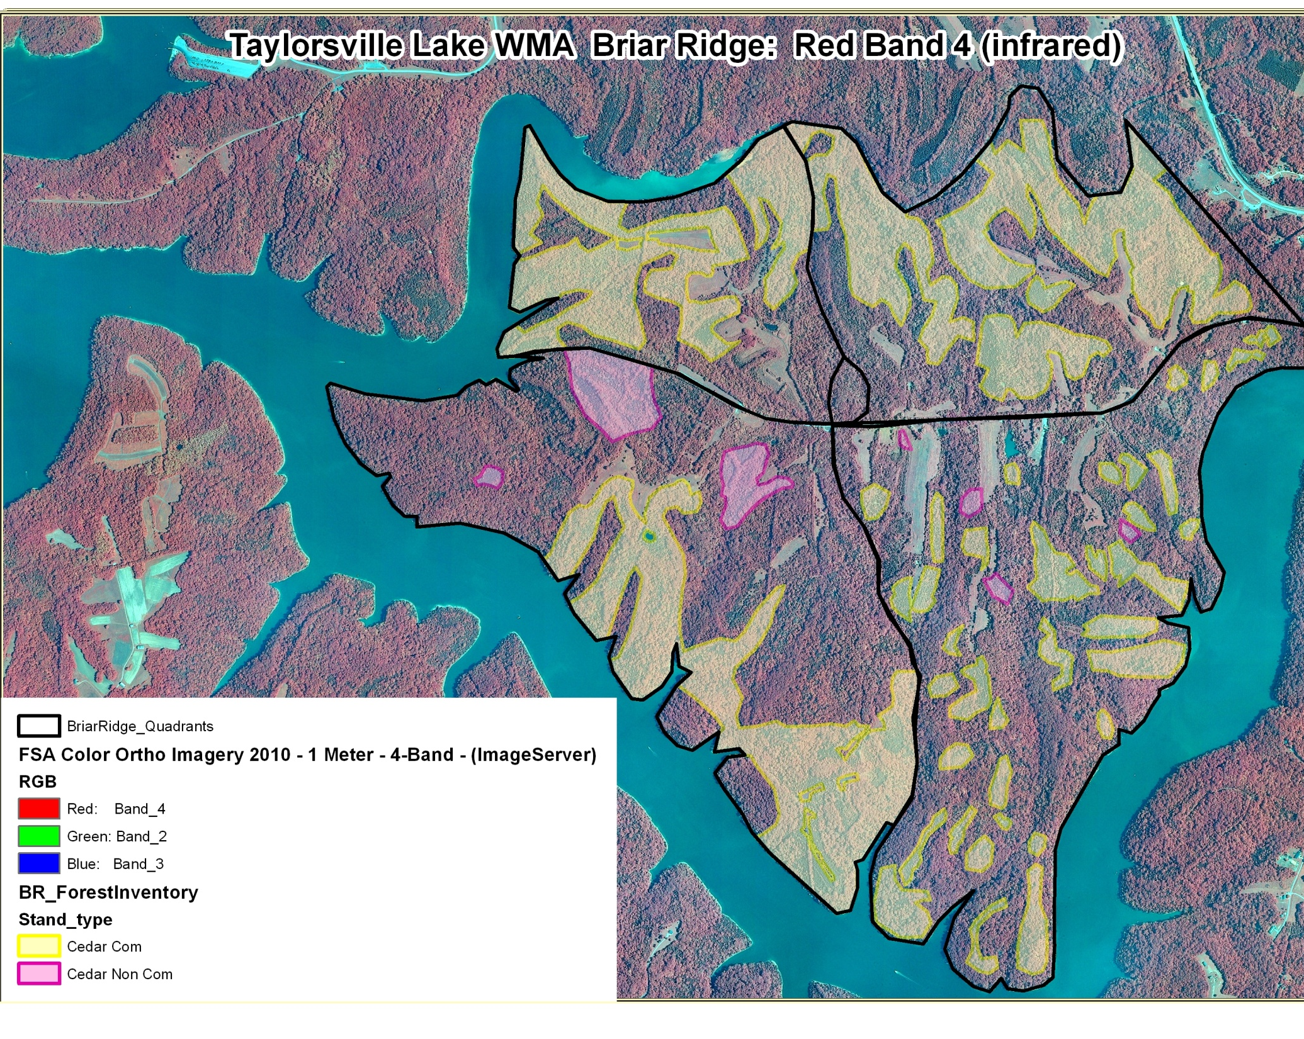

Slide 27
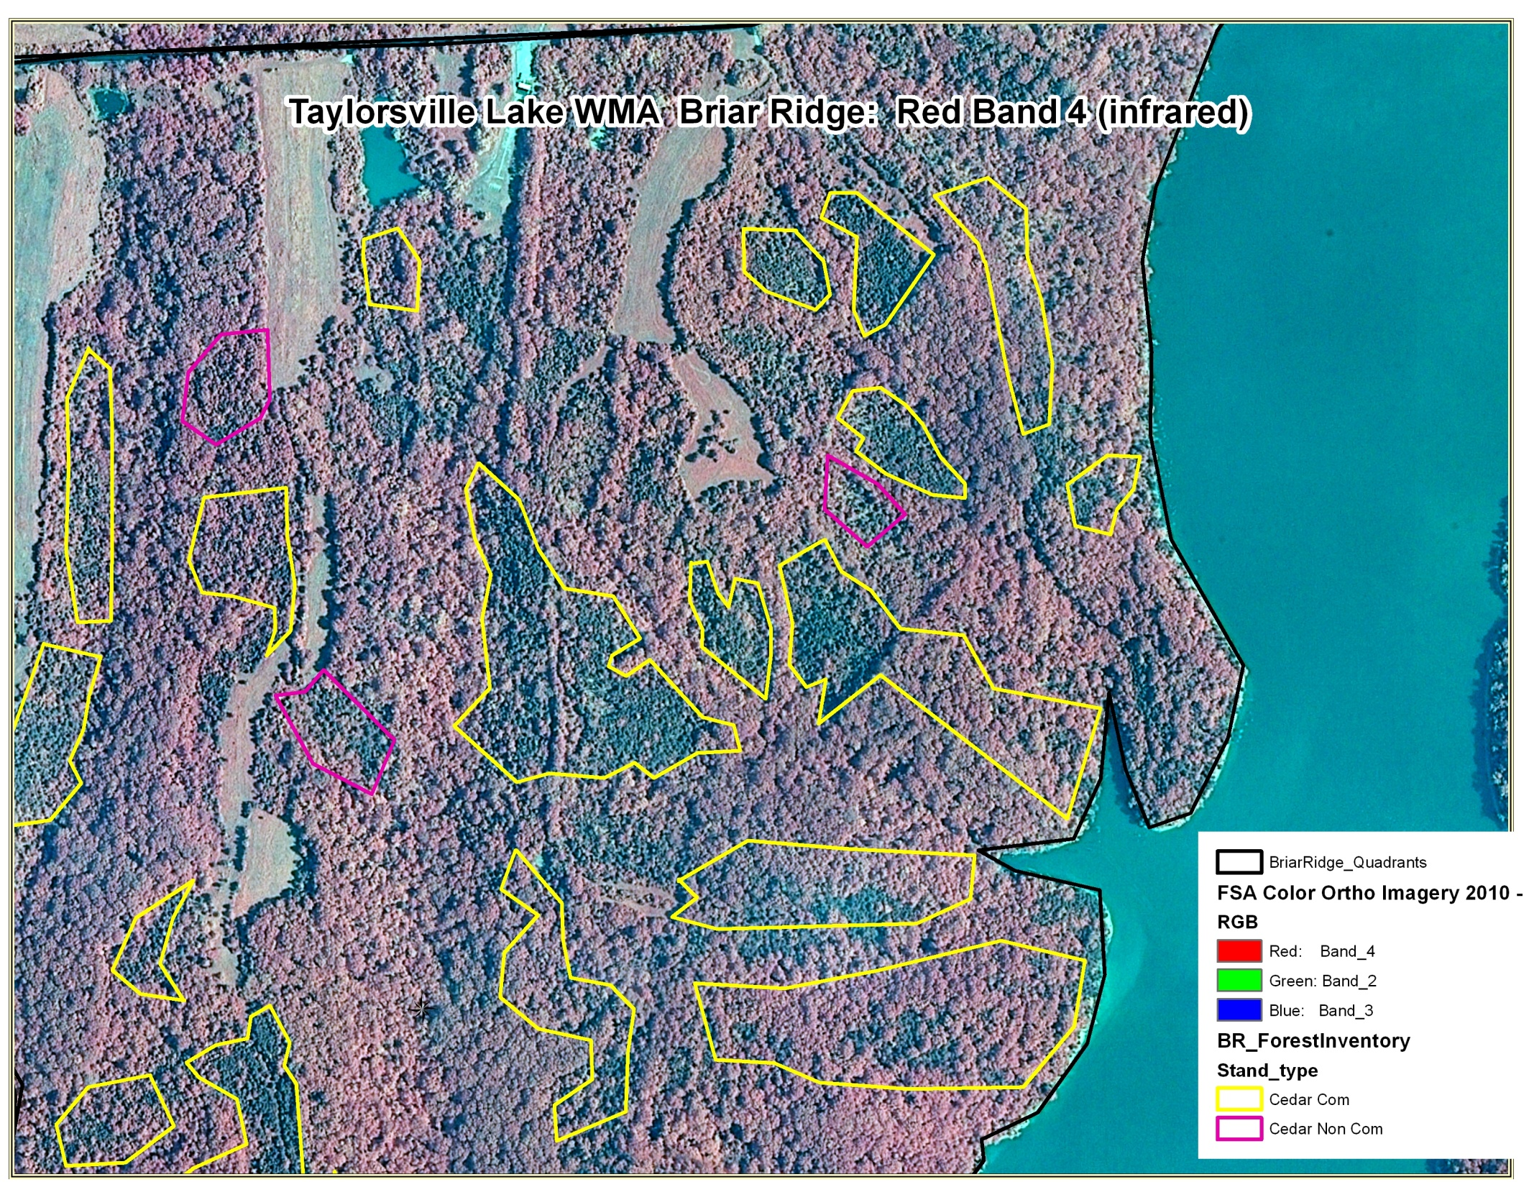

Slide 28
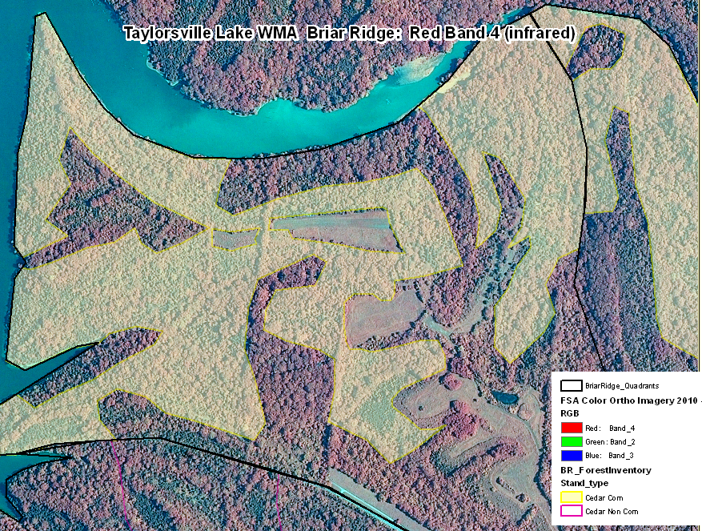

Slide 29
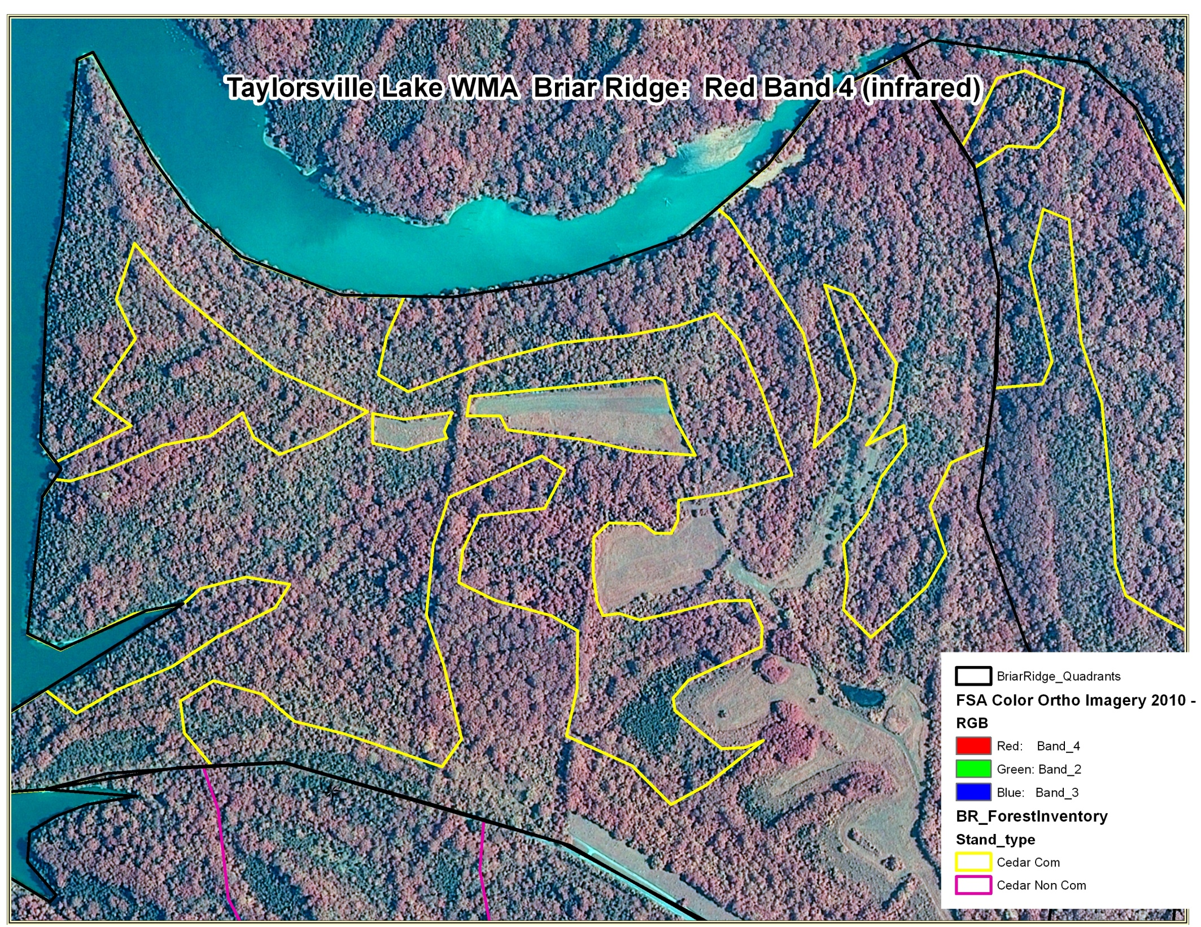

Slide 30
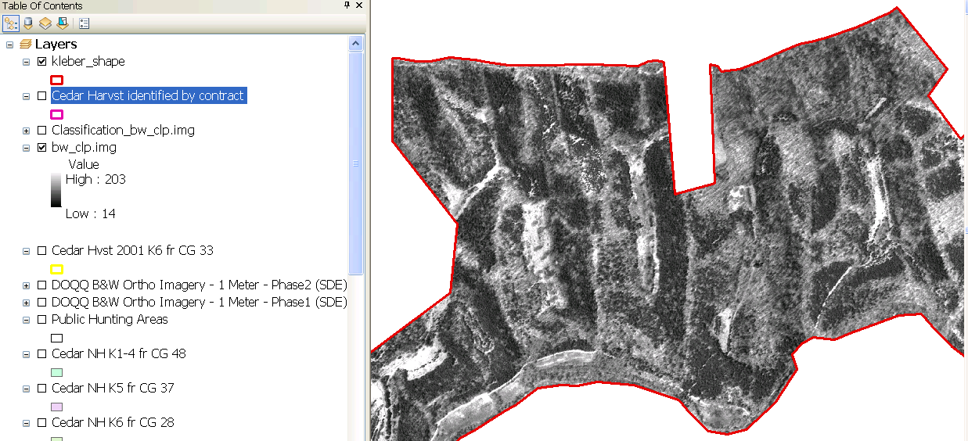
Potion of Kleber WMA

Slide 31
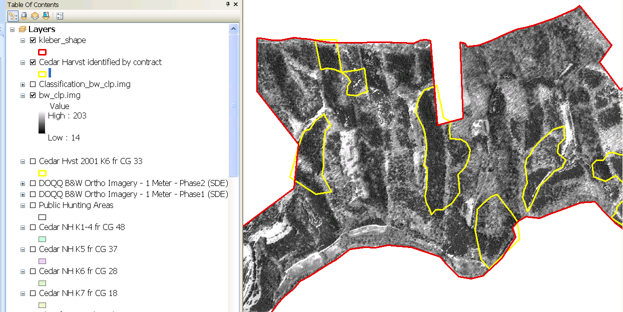
Cedar areas identified for harvest by contractor

Slide 32
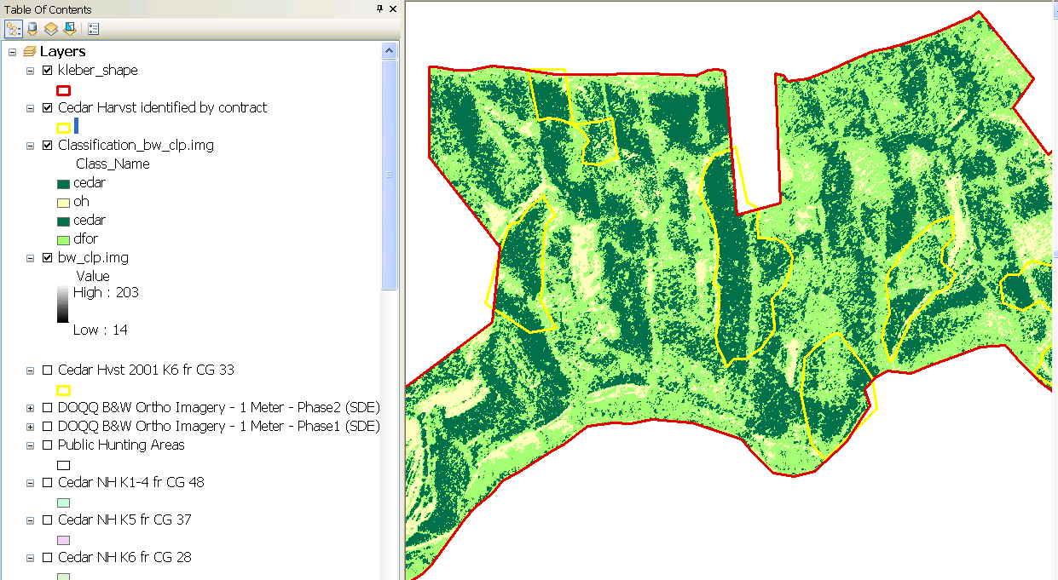
Cedar areas identified by image analysis

Slide 33
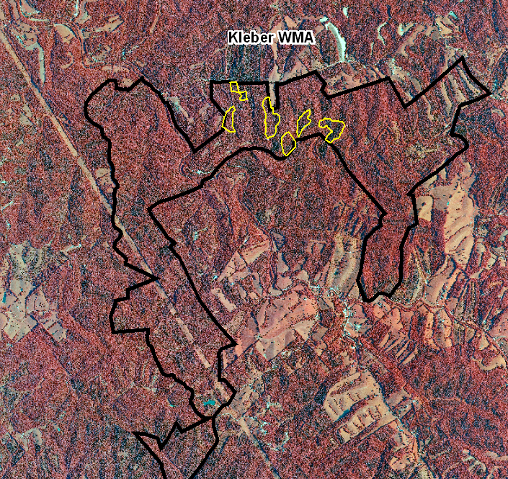

Slide 34
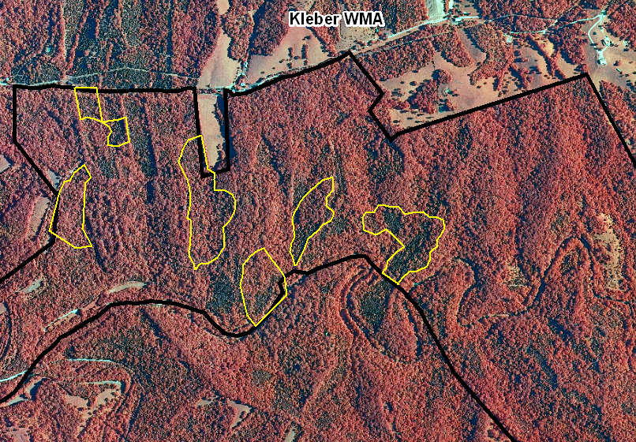

Slide 35
Cedar areas identified by image analysis

Slide 36
Conclusions
Near infrared leaf-on imagery can help identify cedar stands
Very sensitive to image quality
Can not (yet) distinguish commercial Vs non-commercial
Could be useful for targeting traditional inventory
Image Analyst technique is probably overkill
Visual inspection and hand digitizing good enough

